Slide 1
Small Engine Parts I.D

Slide 2
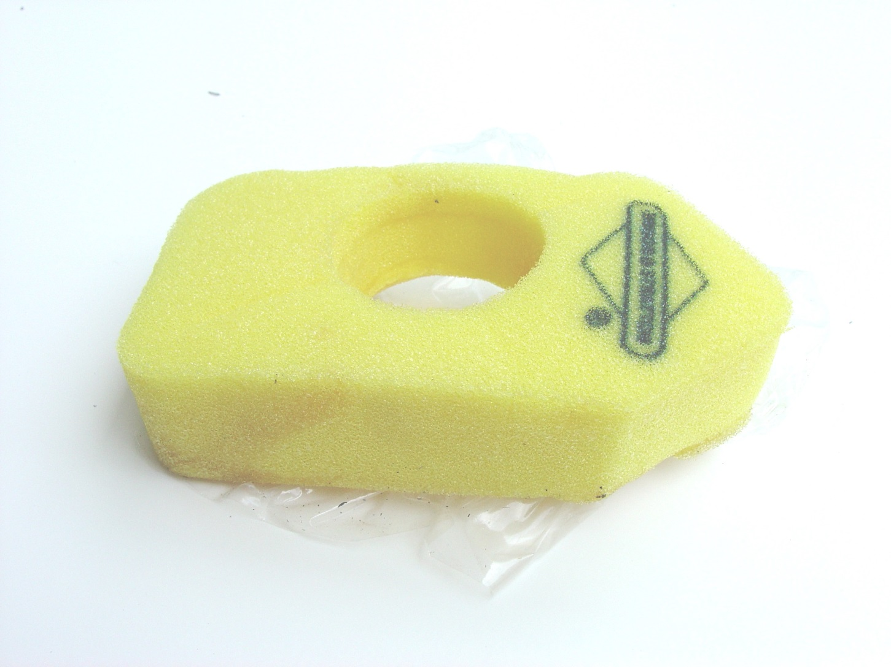

Slide 3
Air Cleaner Foam Filter

Slide 4


Slide 5
Air Cleaner

Slide 6
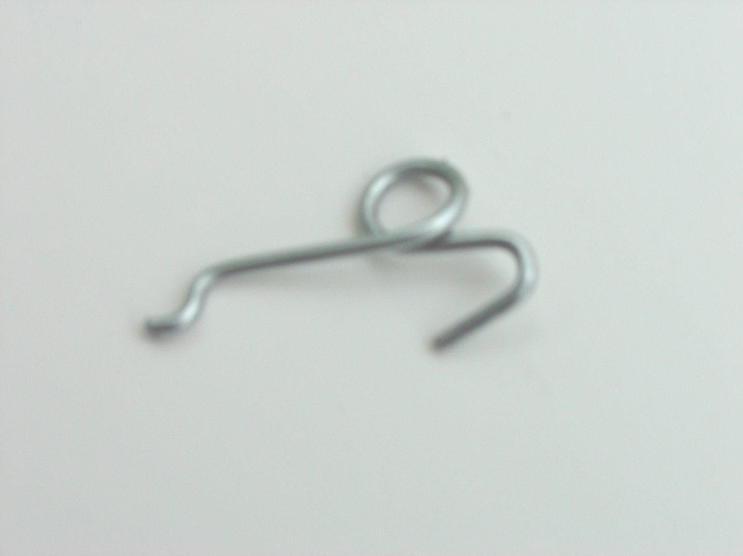

Slide 7
Air Vane Link

Slide 8
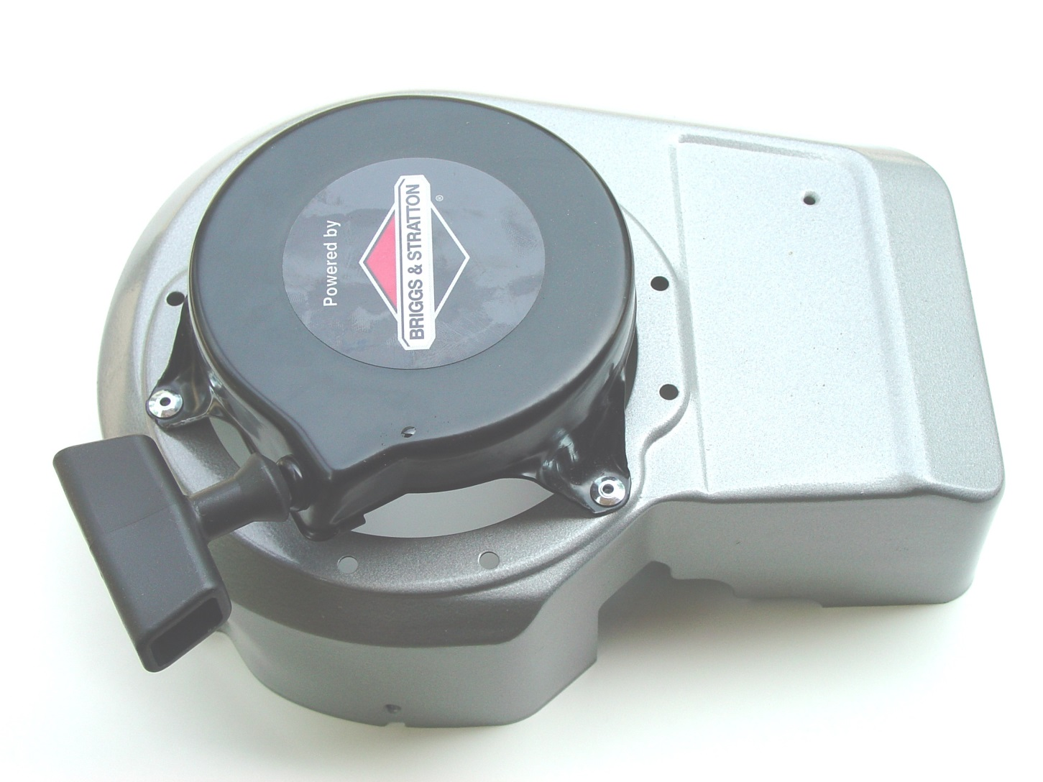

Slide 9
Blower Housing

Slide 10
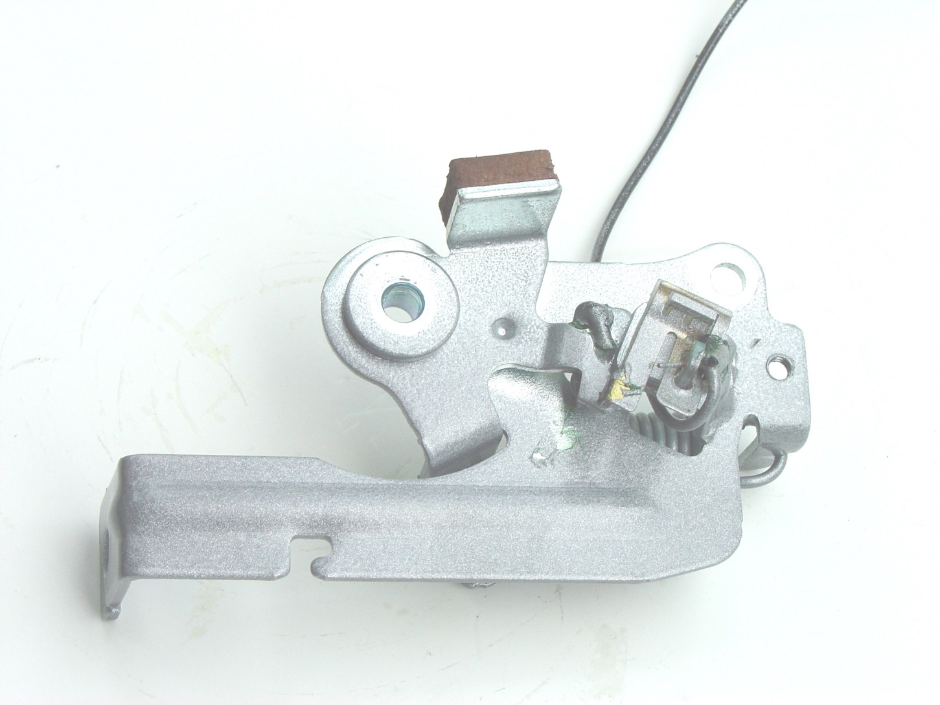

Slide 11
Brake and Stop Switch

Slide 12
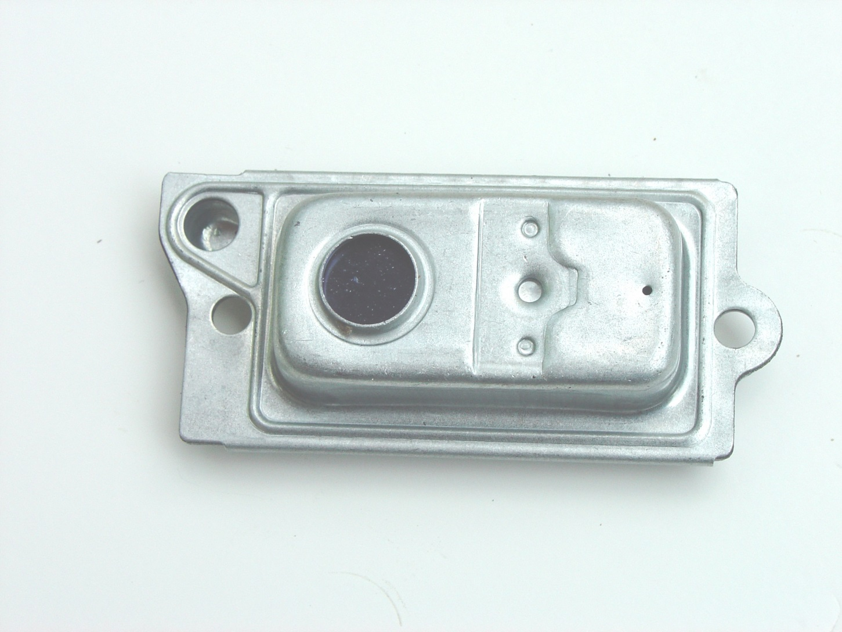

Slide 13
Breather Assembly

Slide 14
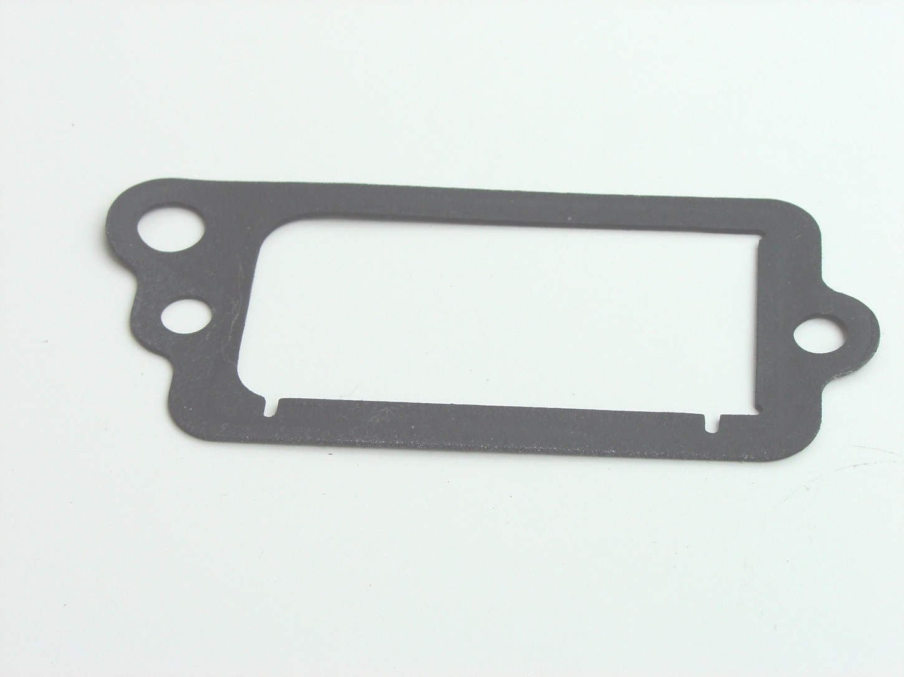

Slide 15
Breather Gasket

Slide 16
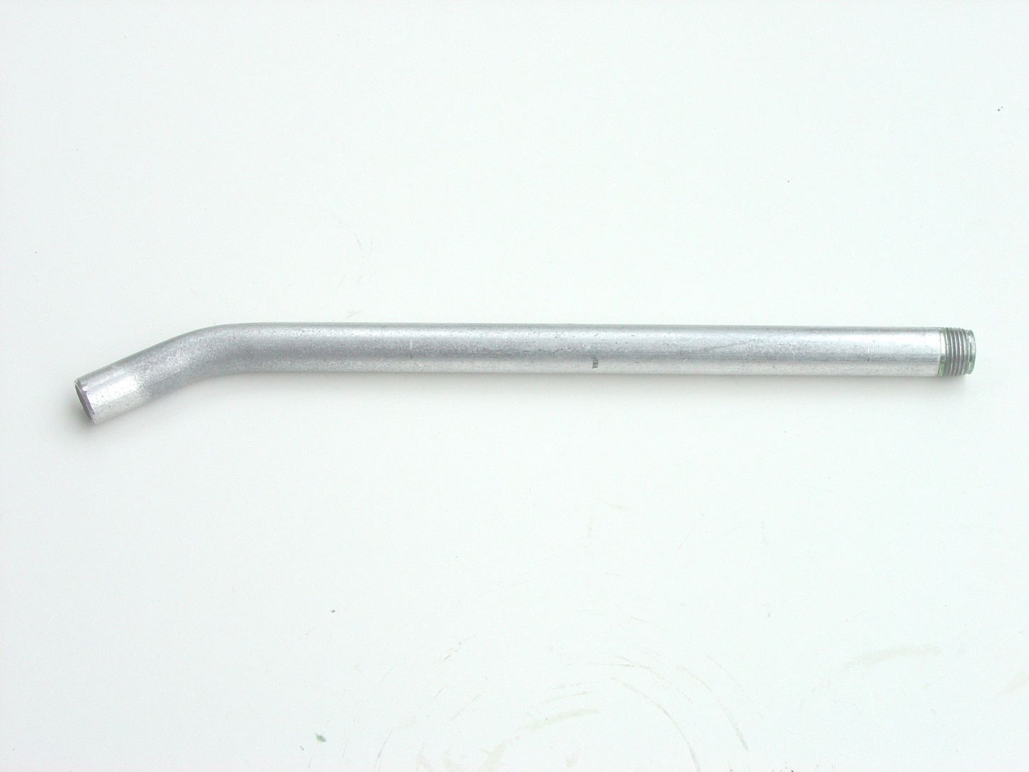

Slide 17
Breather Tube

Slide 18
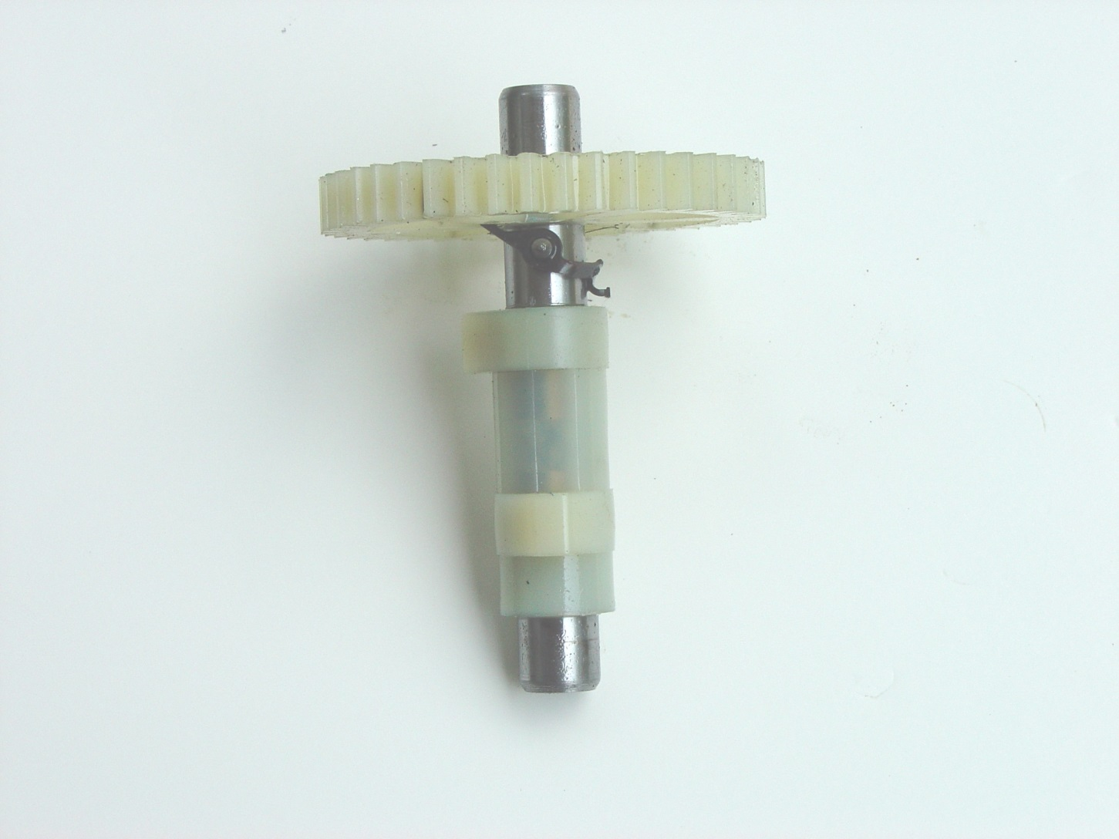

Slide 19
Camshaft

Slide 20
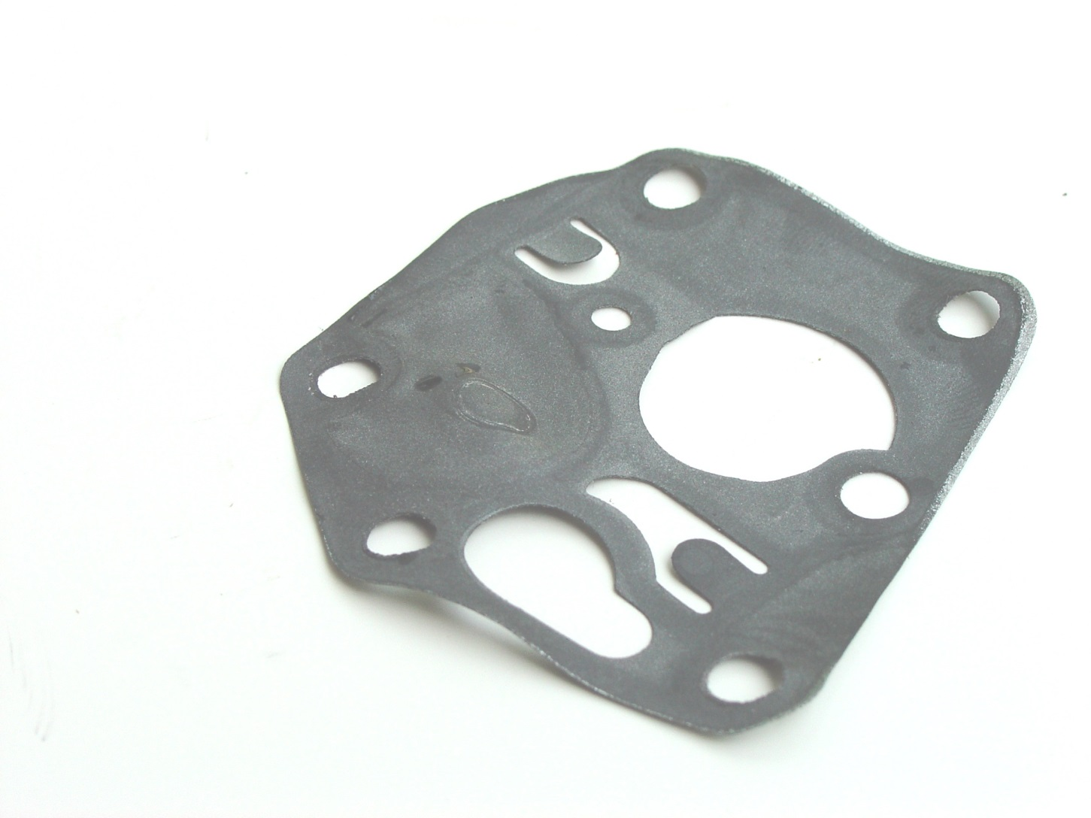

Slide 21
Carburetor Diaphragm

Slide 22
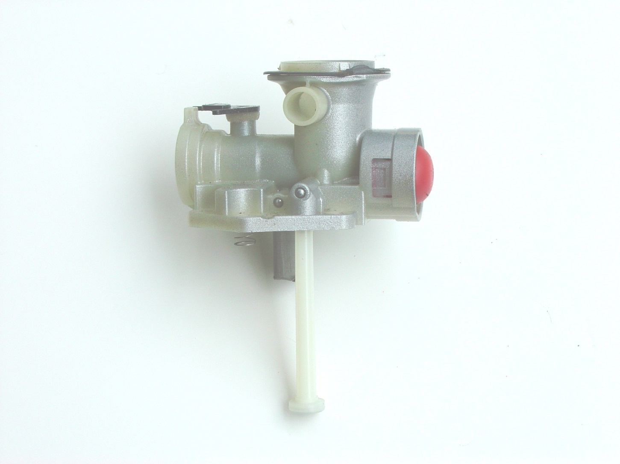

Slide 23
Carburetor

Slide 24
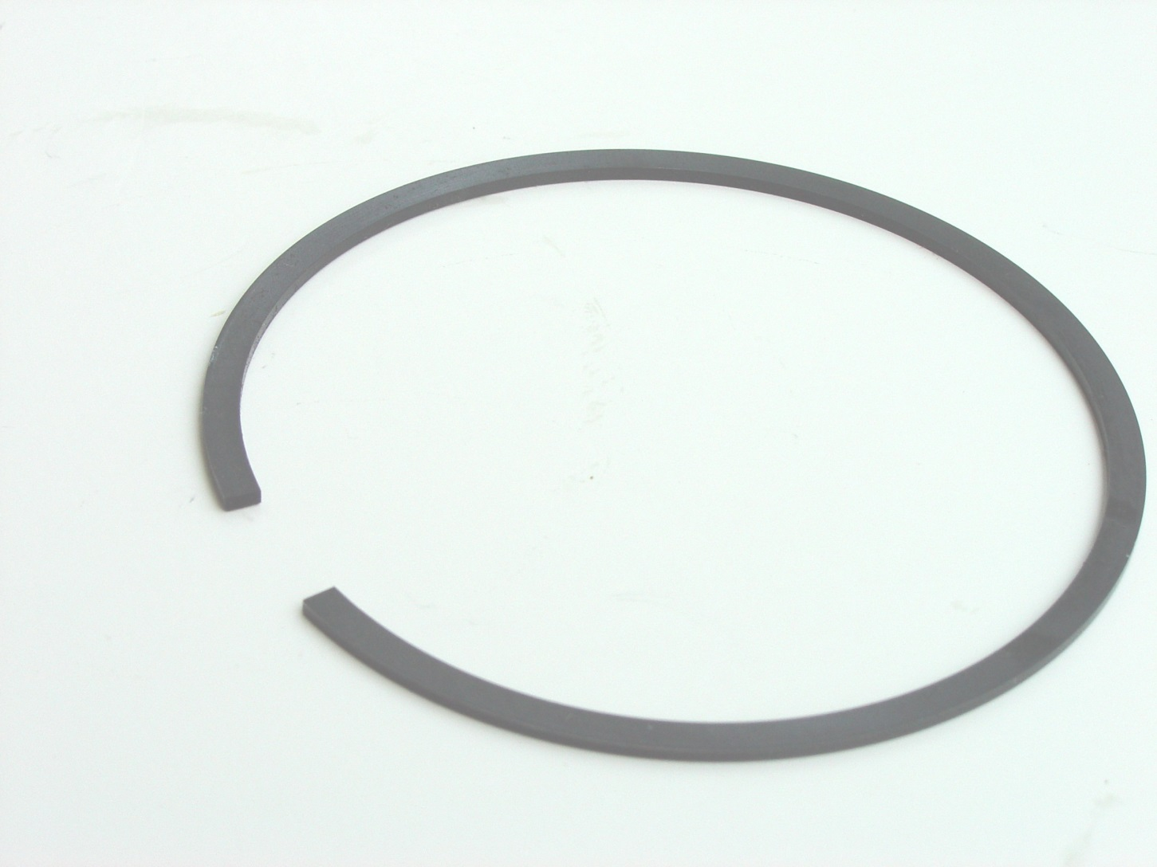

Slide 25
Compression Ring

Slide 26
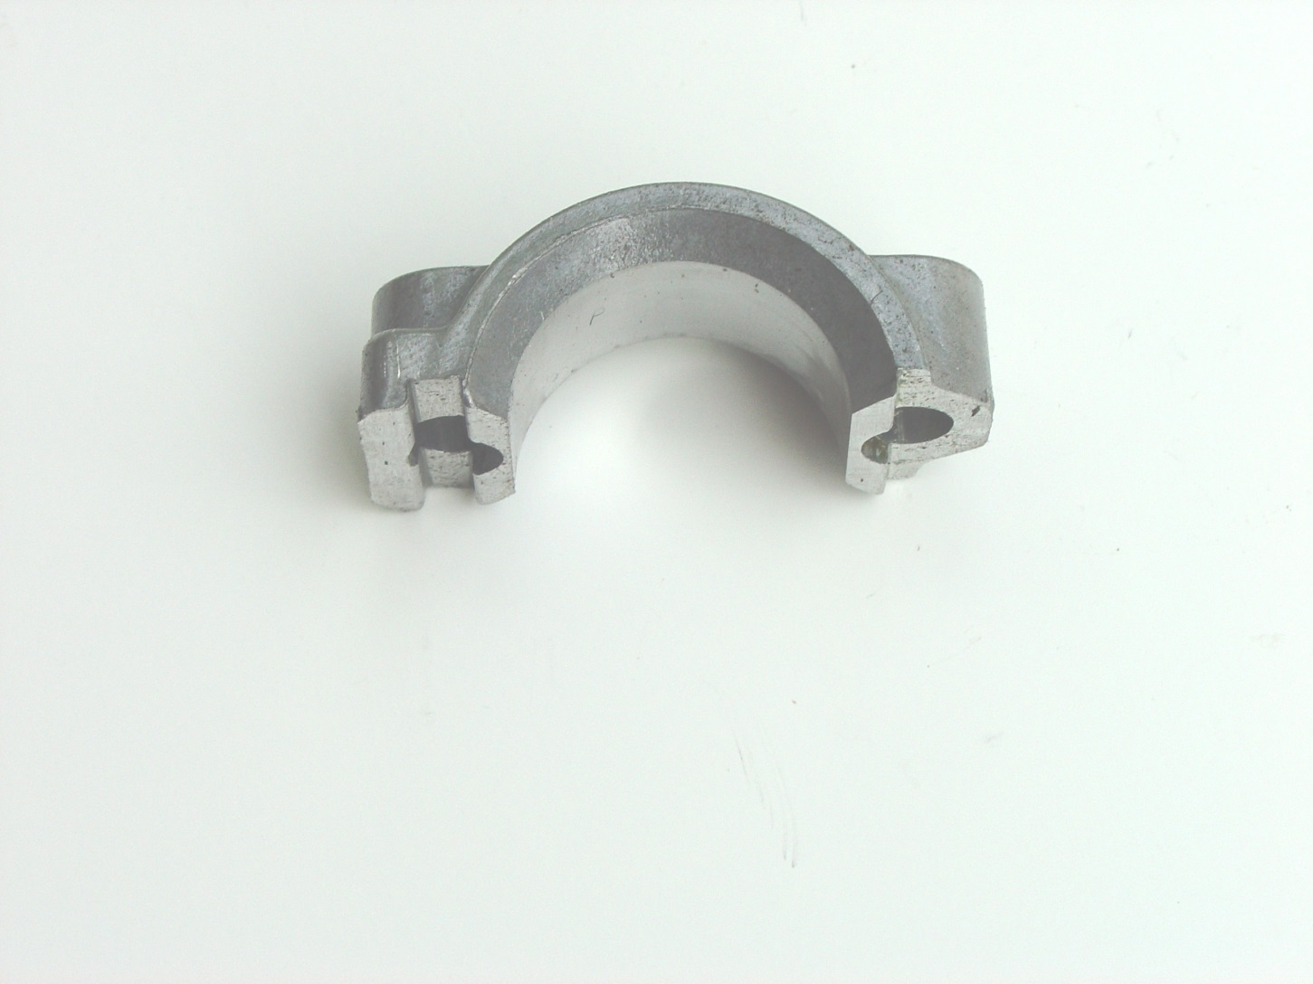

Slide 27
Connecting rod cap

Slide 28
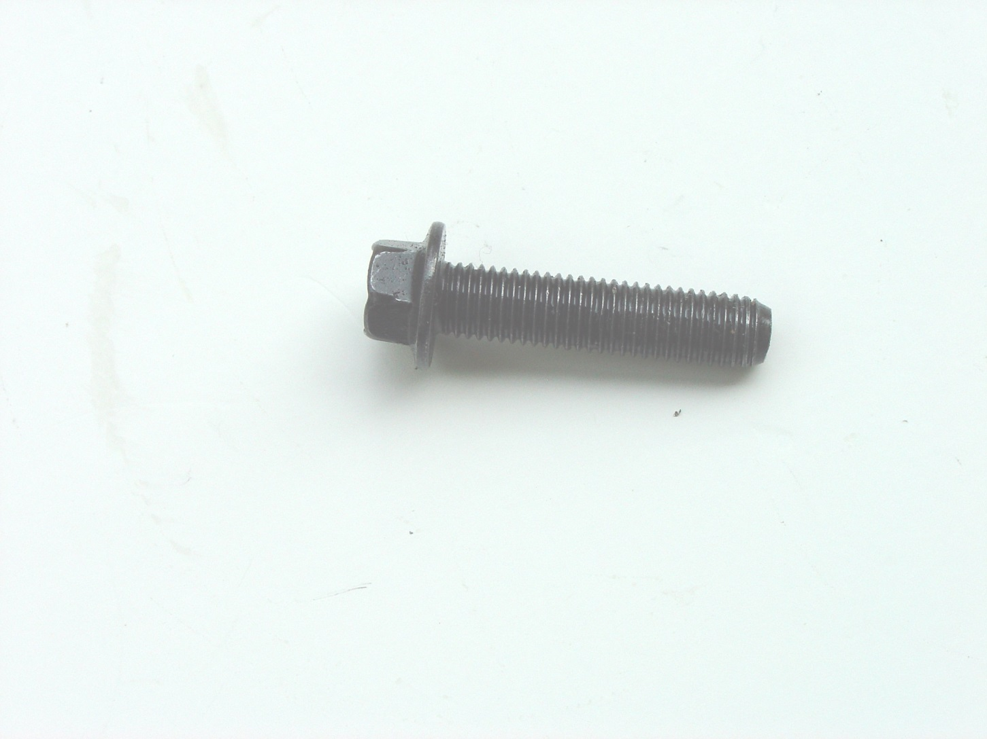

Slide 29
Connecting Rod Screw

Slide 30
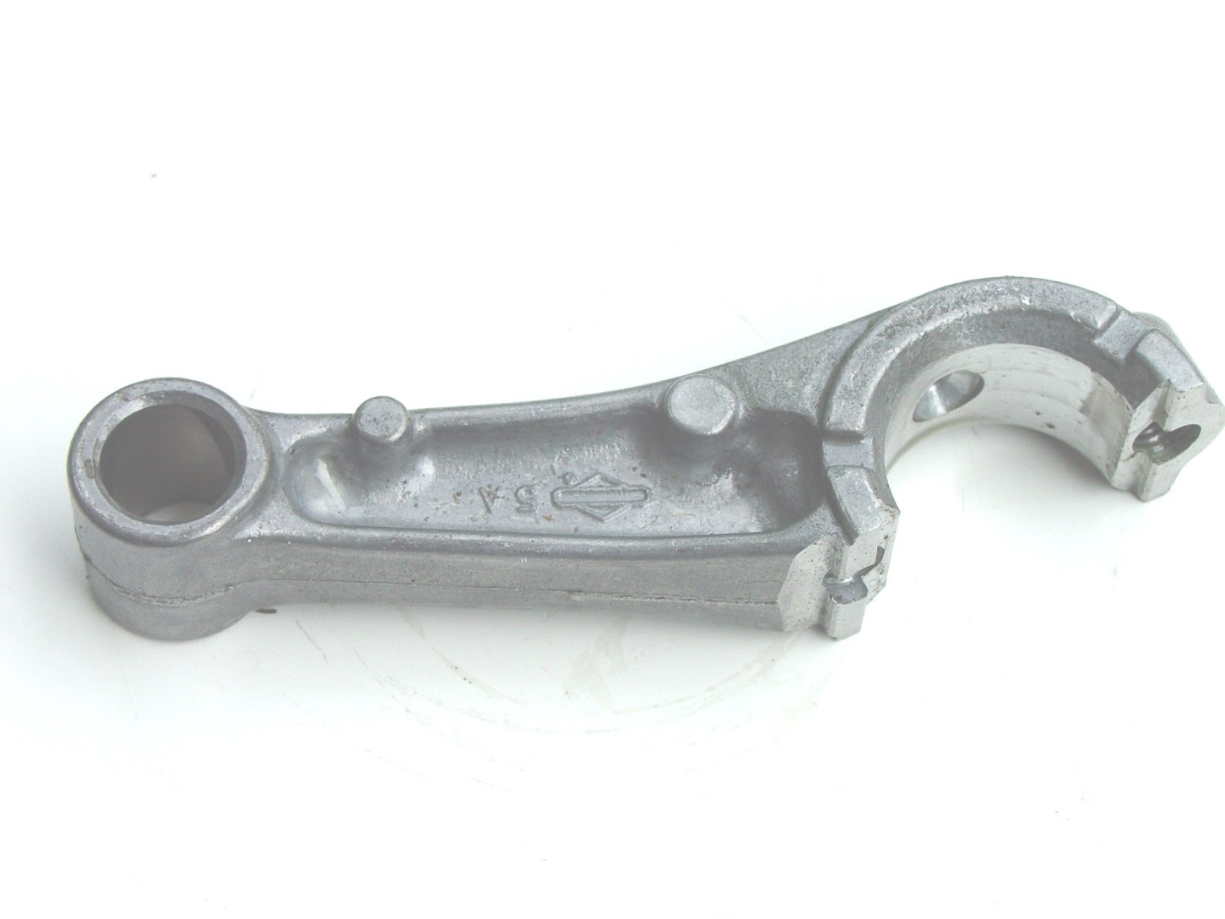

Slide 31
Connecting Rod

Slide 32
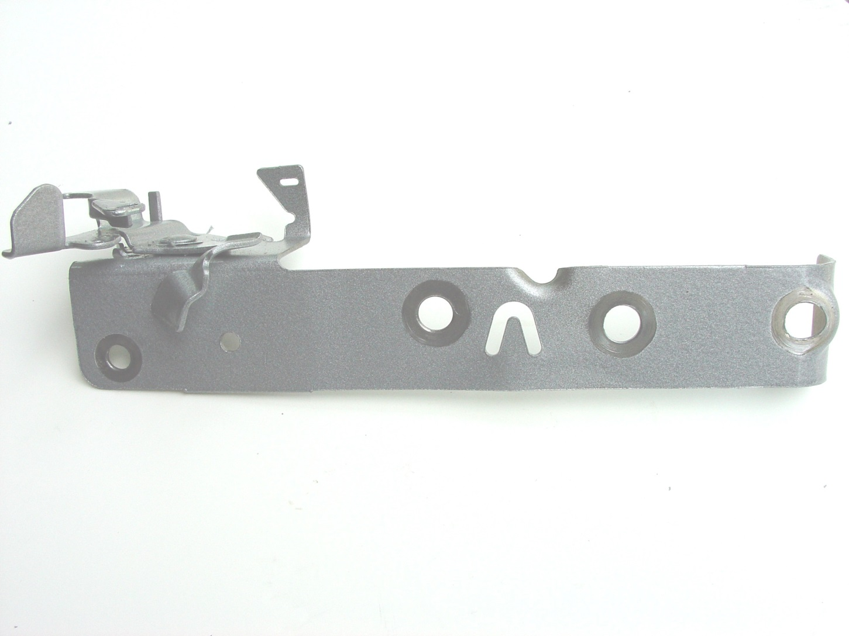

Slide 33
Control Bracket

Slide 34
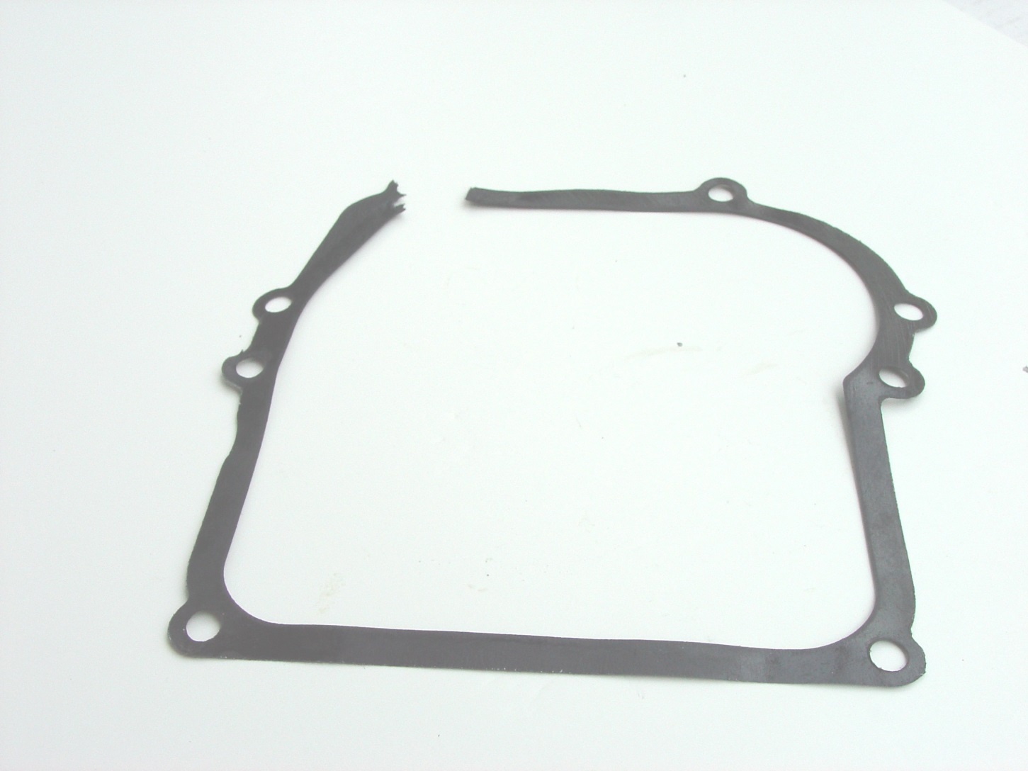

Slide 35
Crankcase Gasket

Slide 36
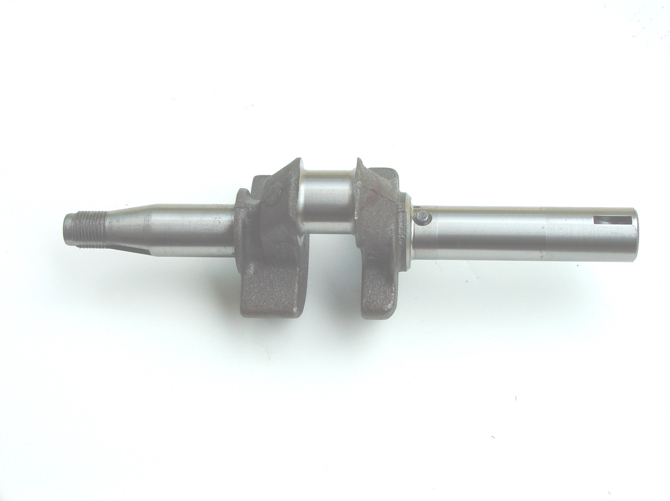

Slide 37
Crankshaft

Slide 38
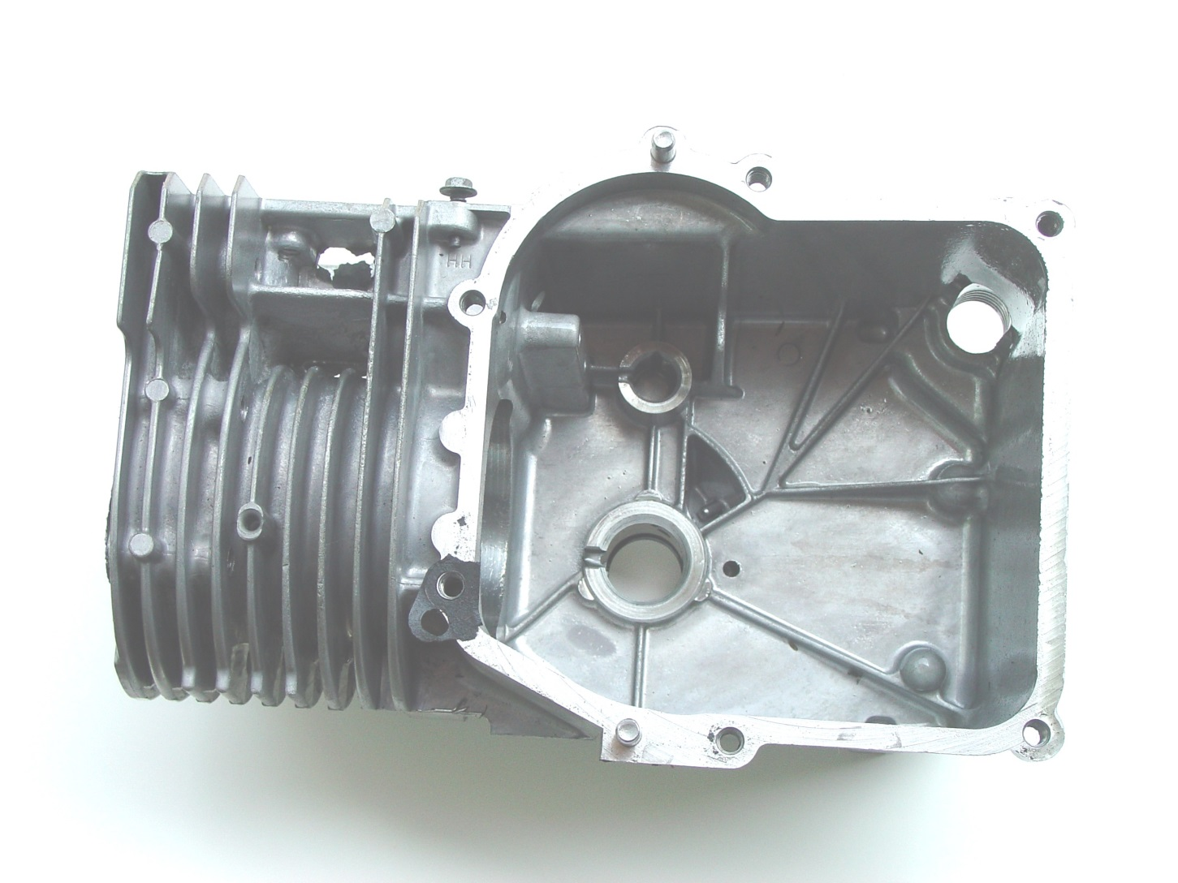

Slide 39
Cylinder Assembly

Slide 40
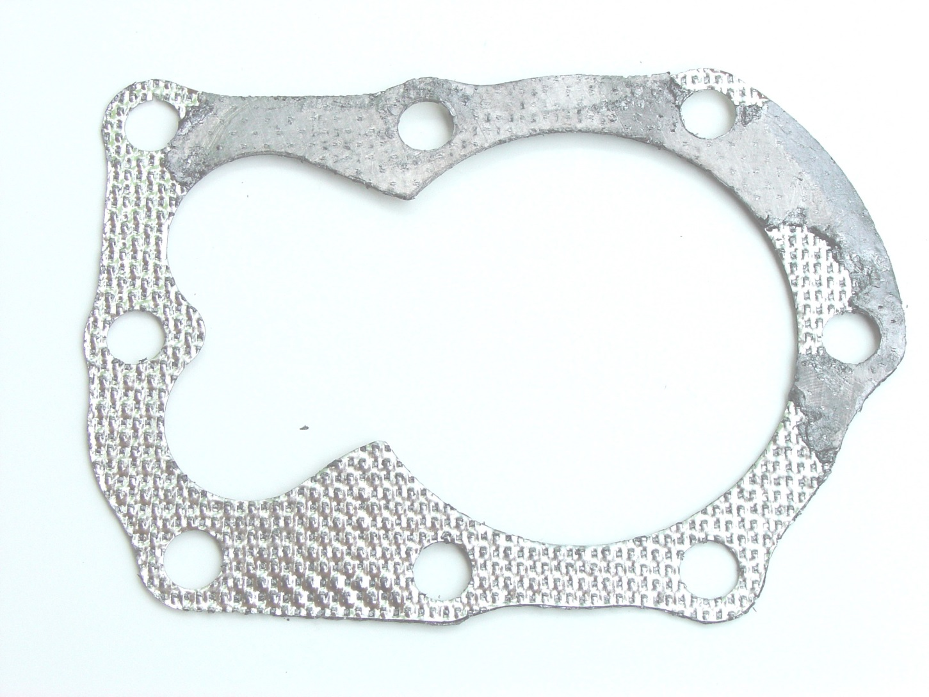

Slide 41
Cylinder Head Gasket

Slide 42
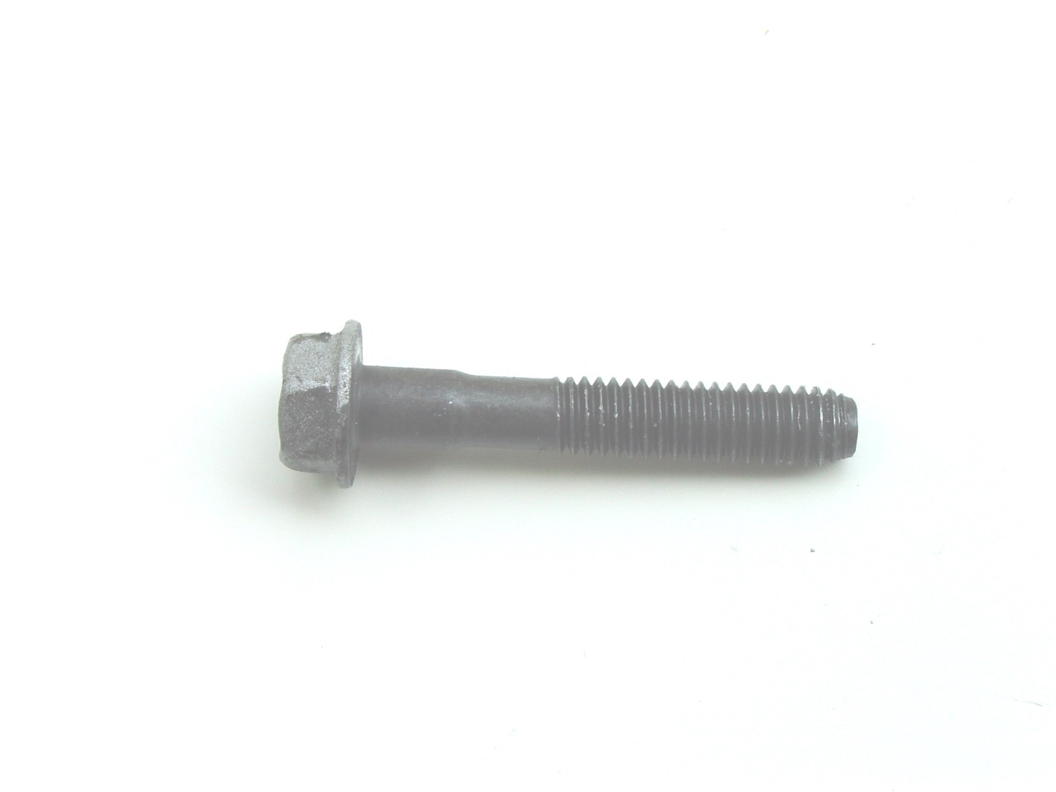

Slide 43
Cylinder Head Screw

Slide 44
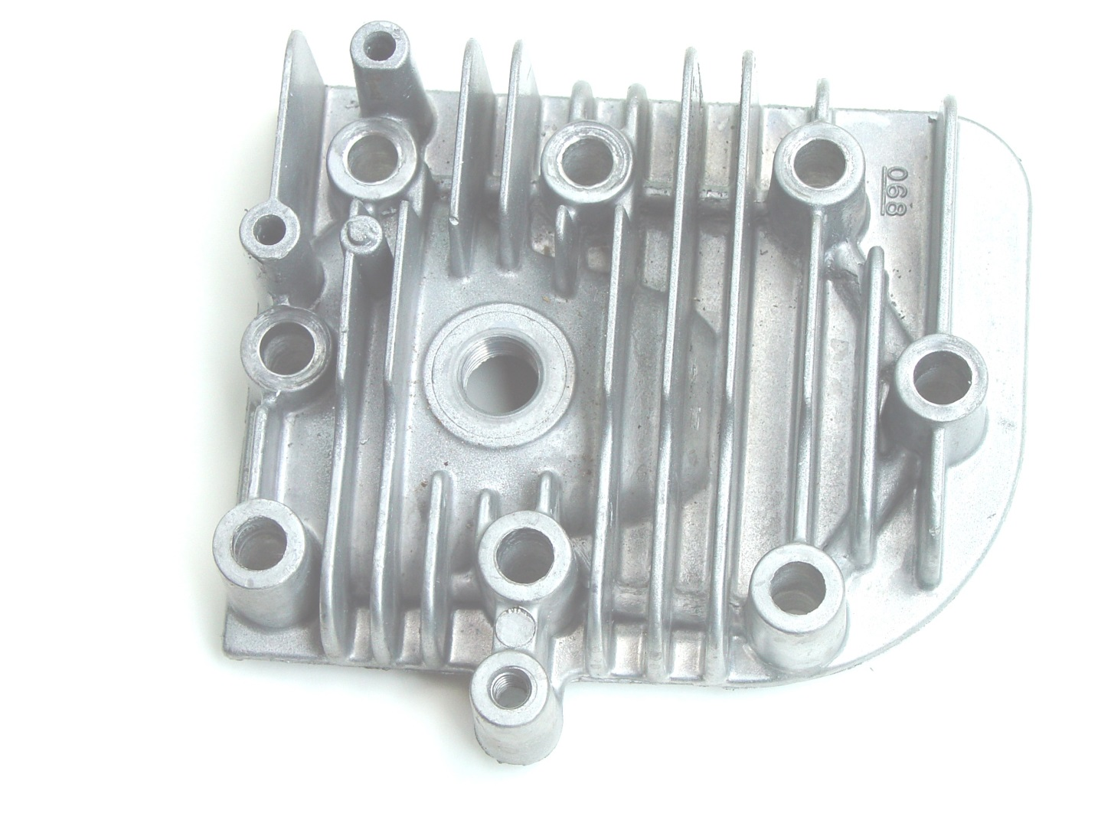

Slide 45
Cylinder Head

Slide 46
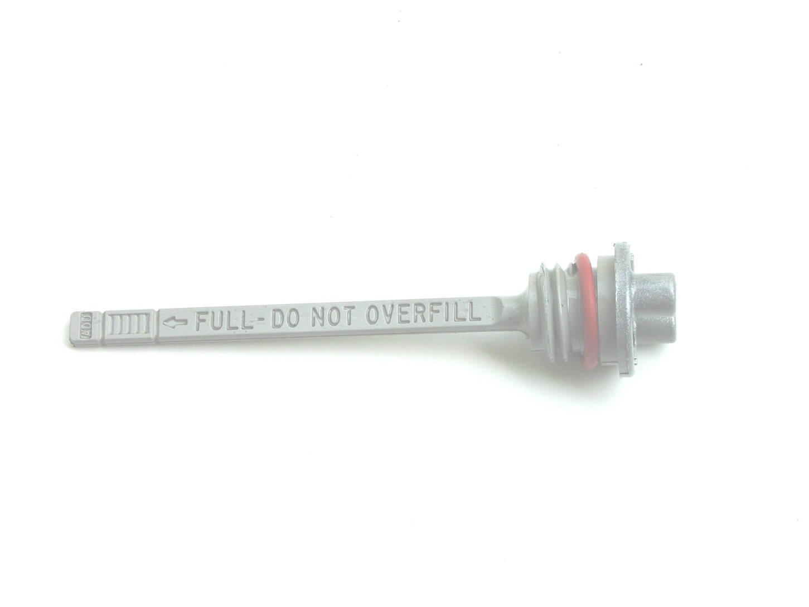

Slide 47
Dipstick

Slide 48
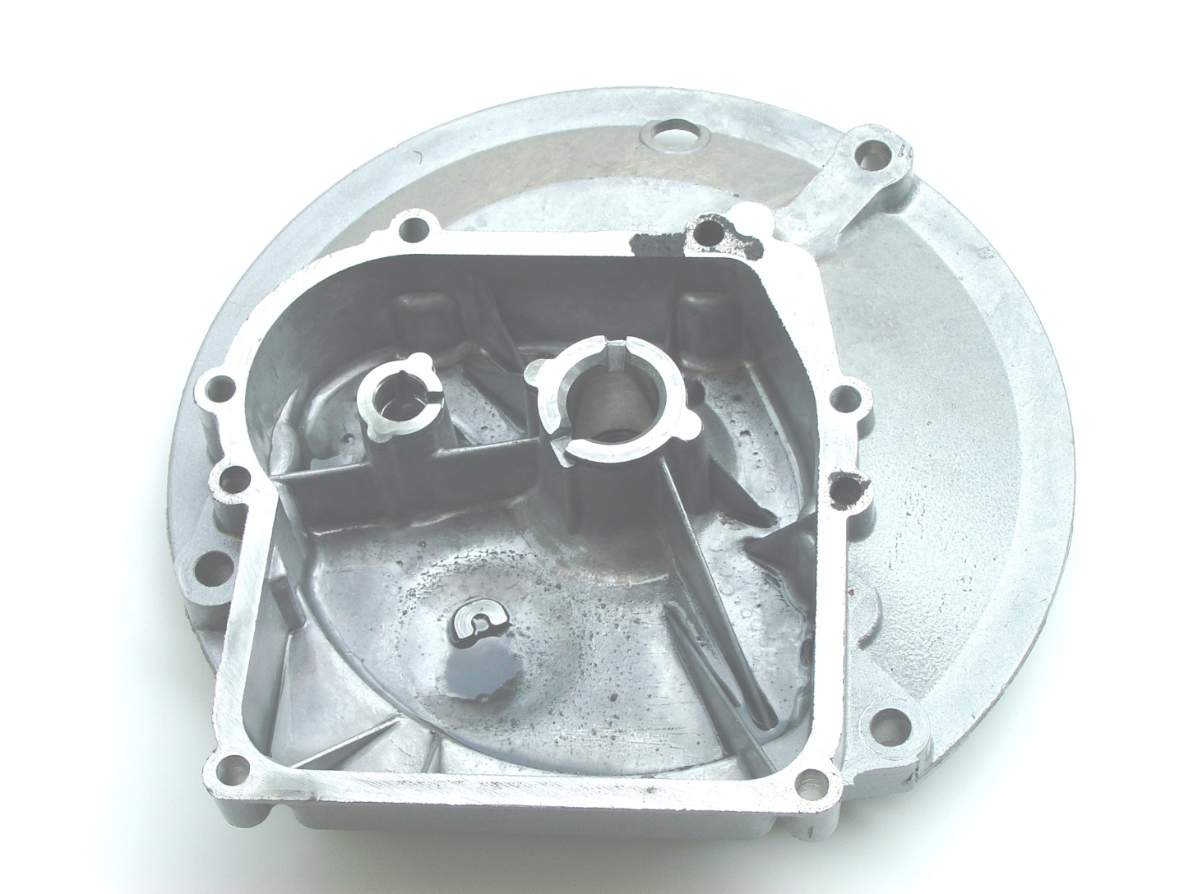

Slide 49
Engine Sump

Slide 50
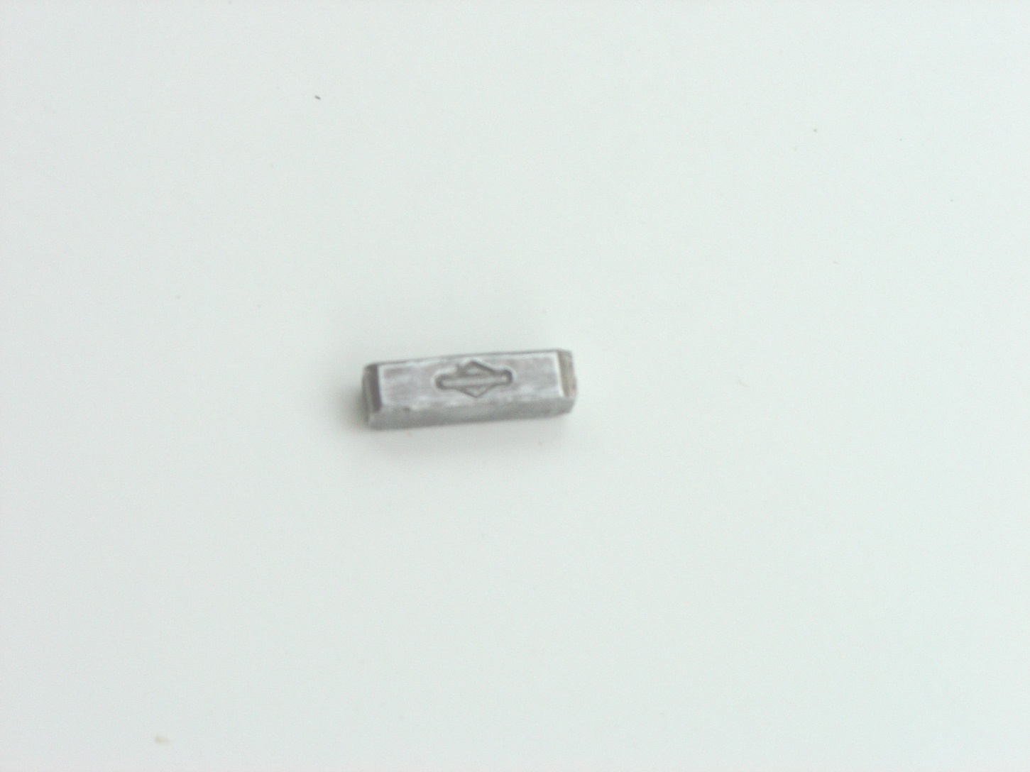

Slide 51
Flywheel Key

Slide 52
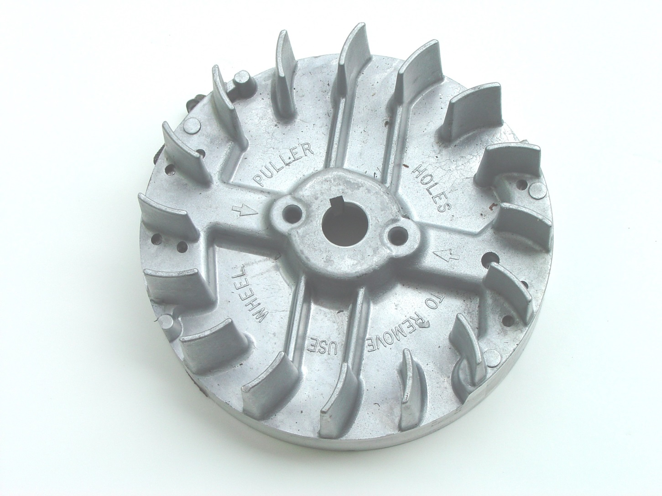

Slide 53
Flywheel

Slide 54
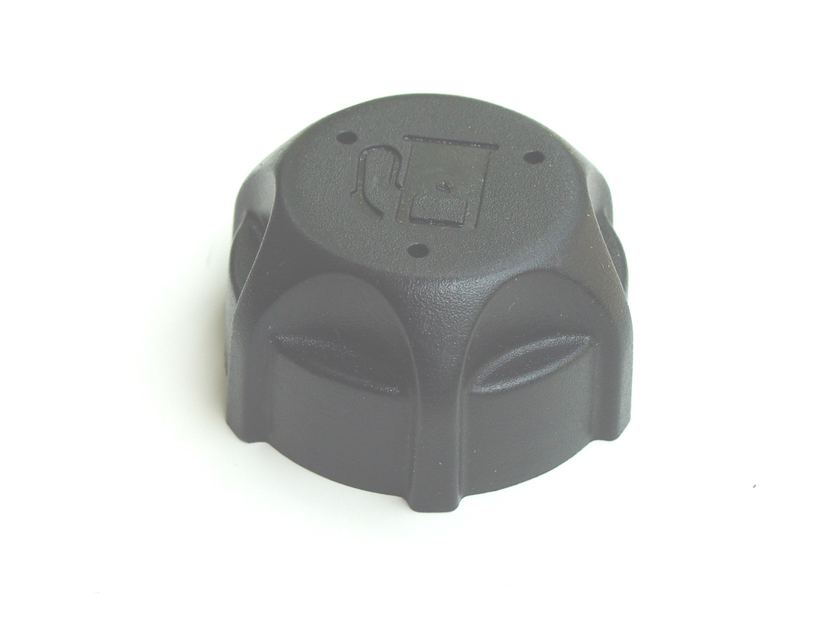

Slide 55
Fuel tank cap

Slide 56
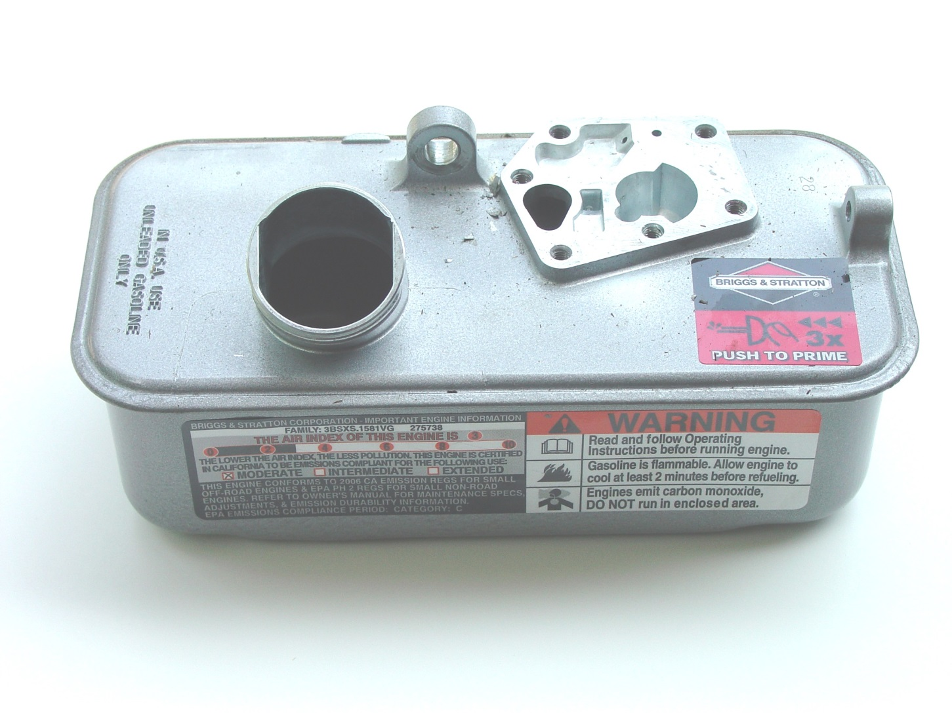

Slide 57
Fuel Tank

Slide 58
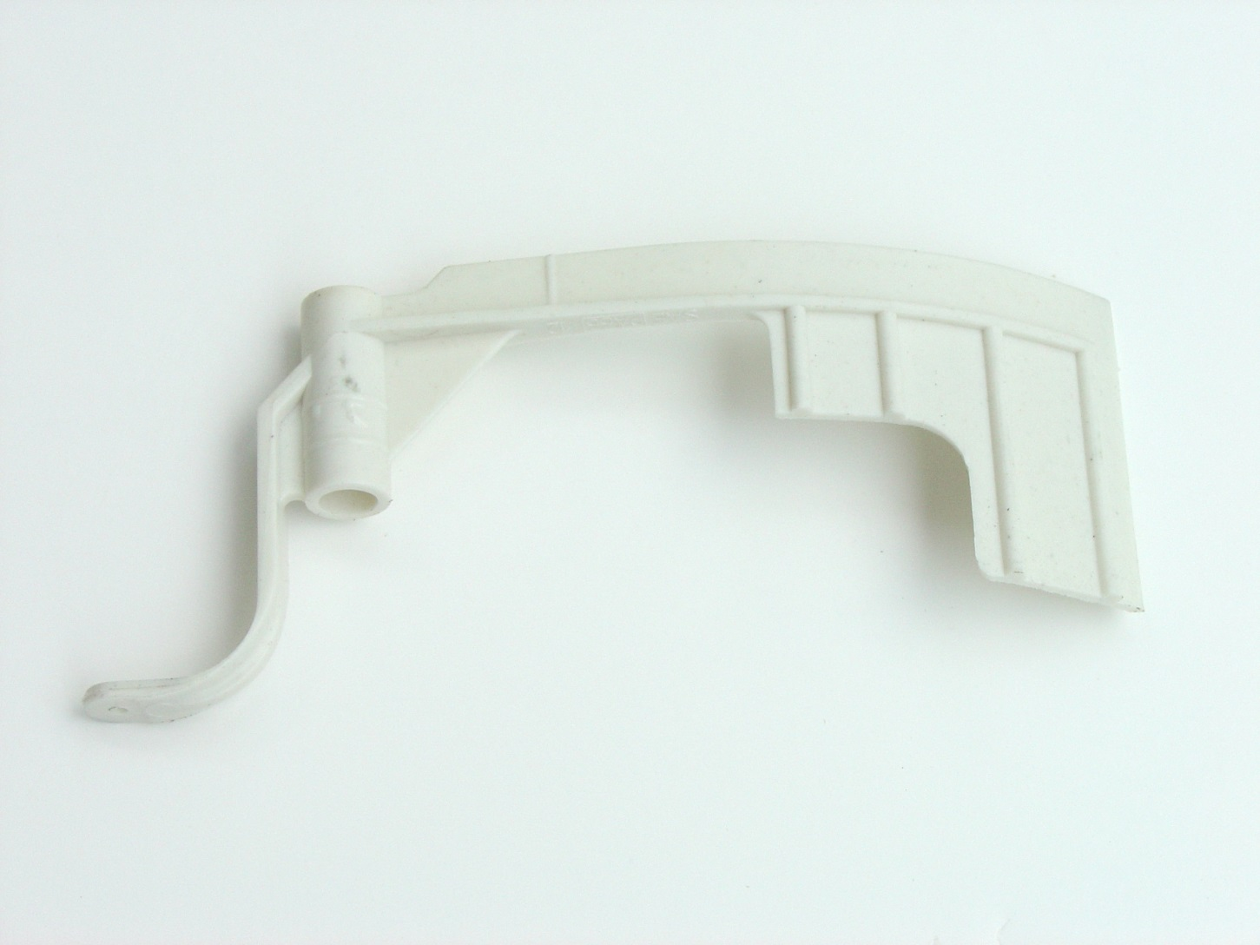

Slide 59
Governor blade

Slide 60
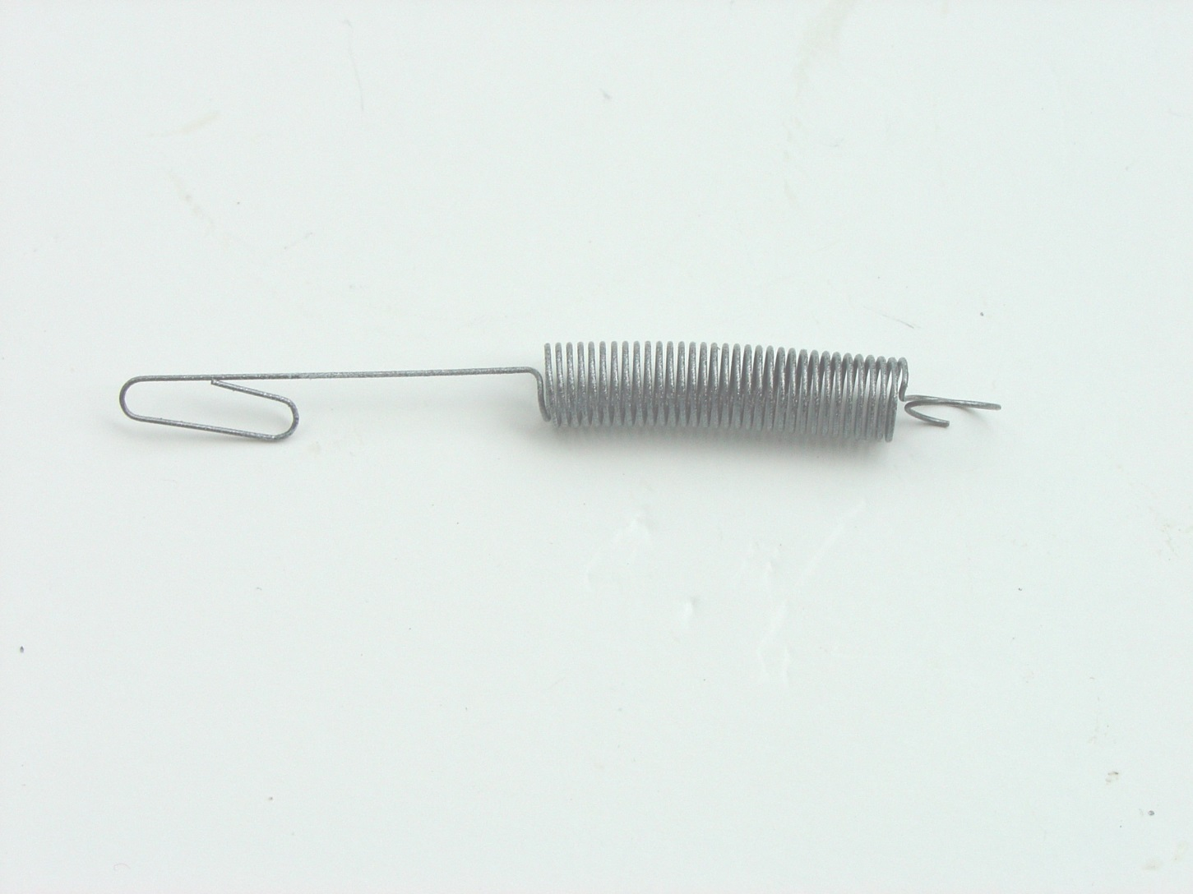

Slide 61
Governor spring

Slide 62
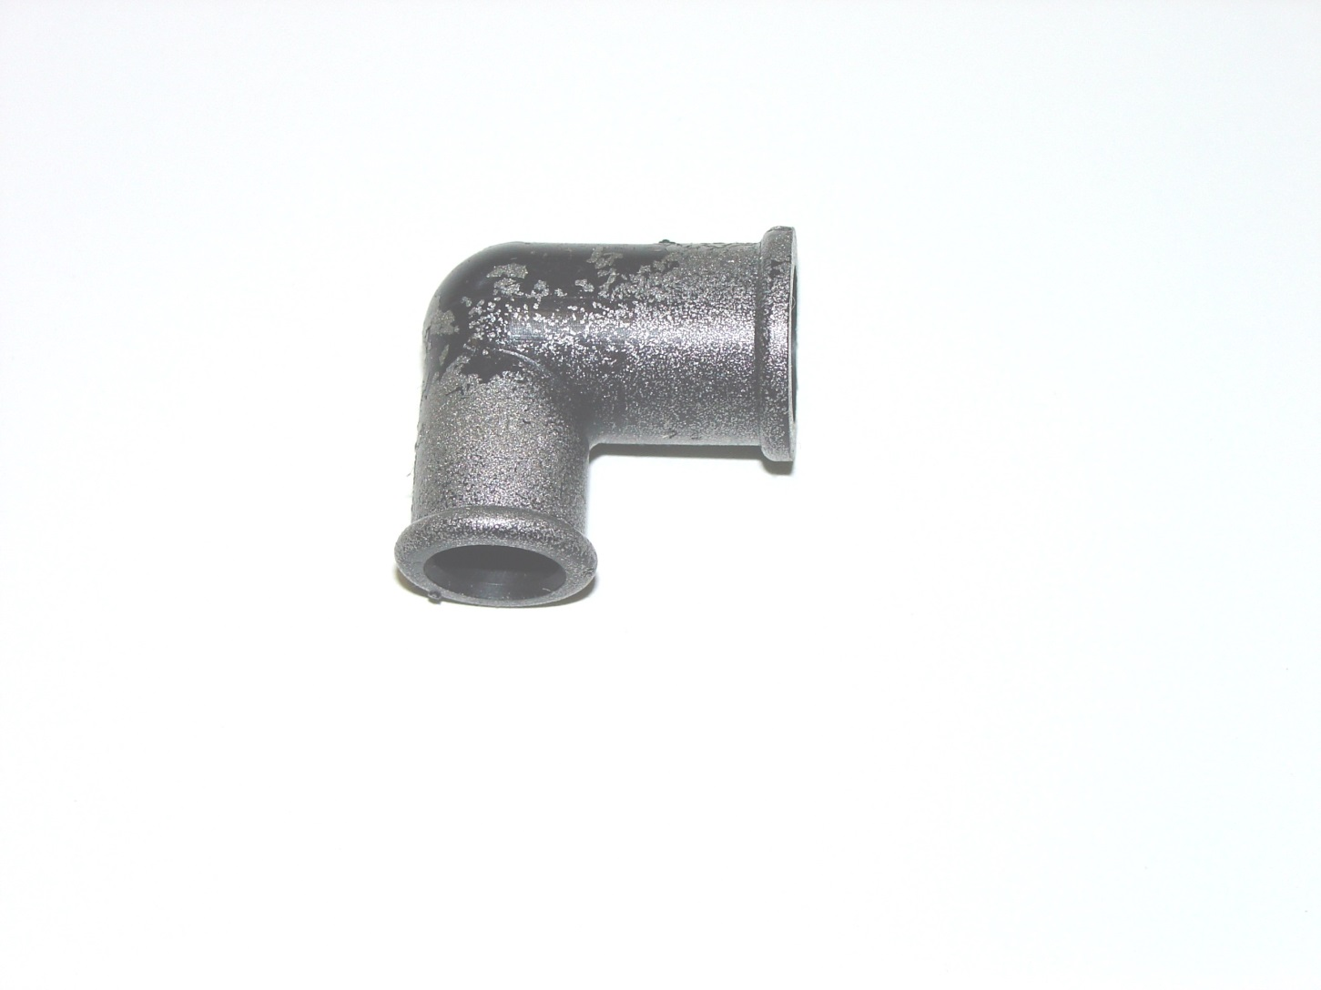

Slide 63
grommet

Slide 64
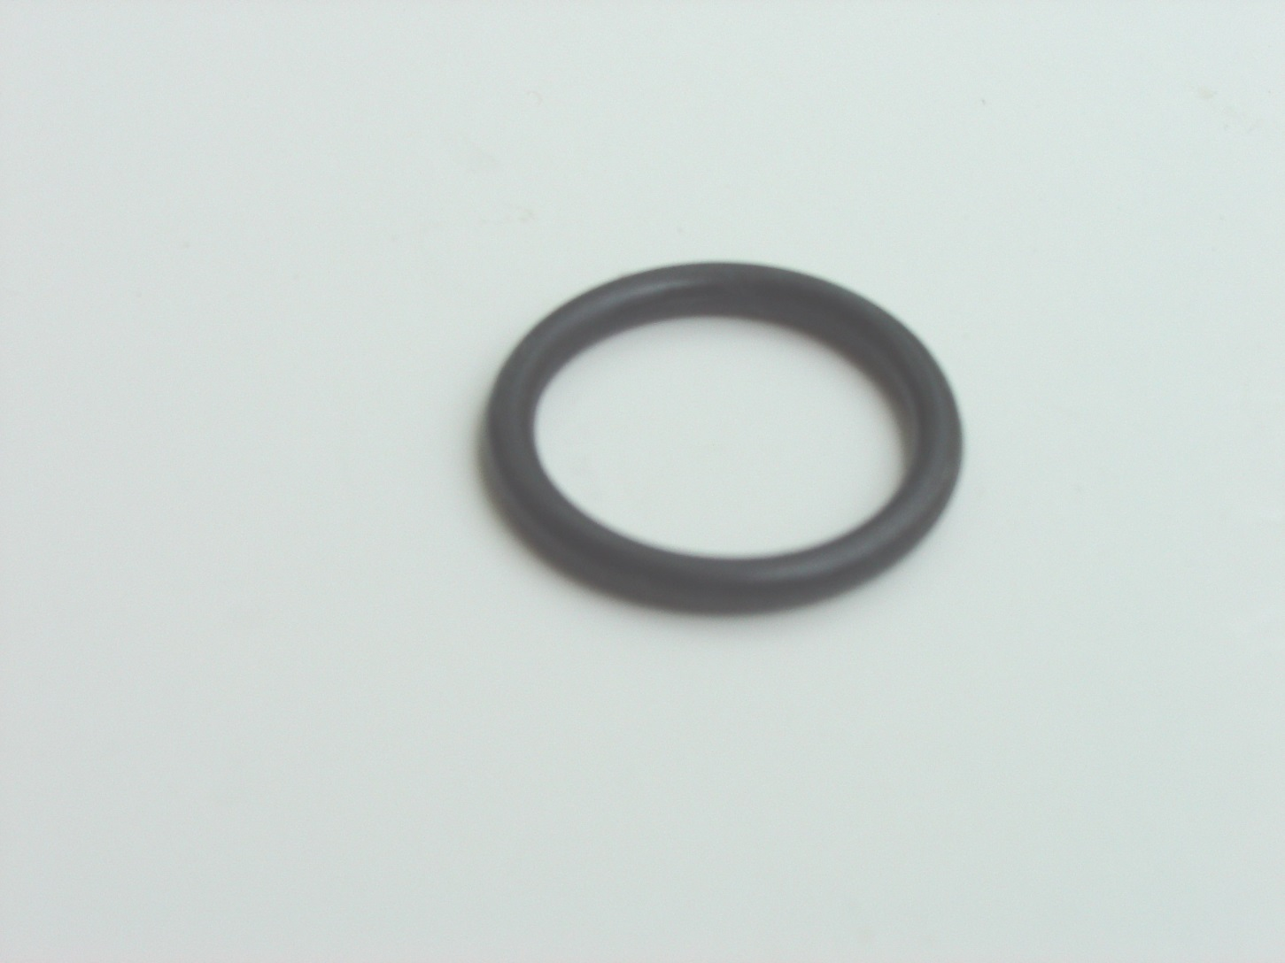

Slide 65
Intake manifold O ring seal

Slide 66
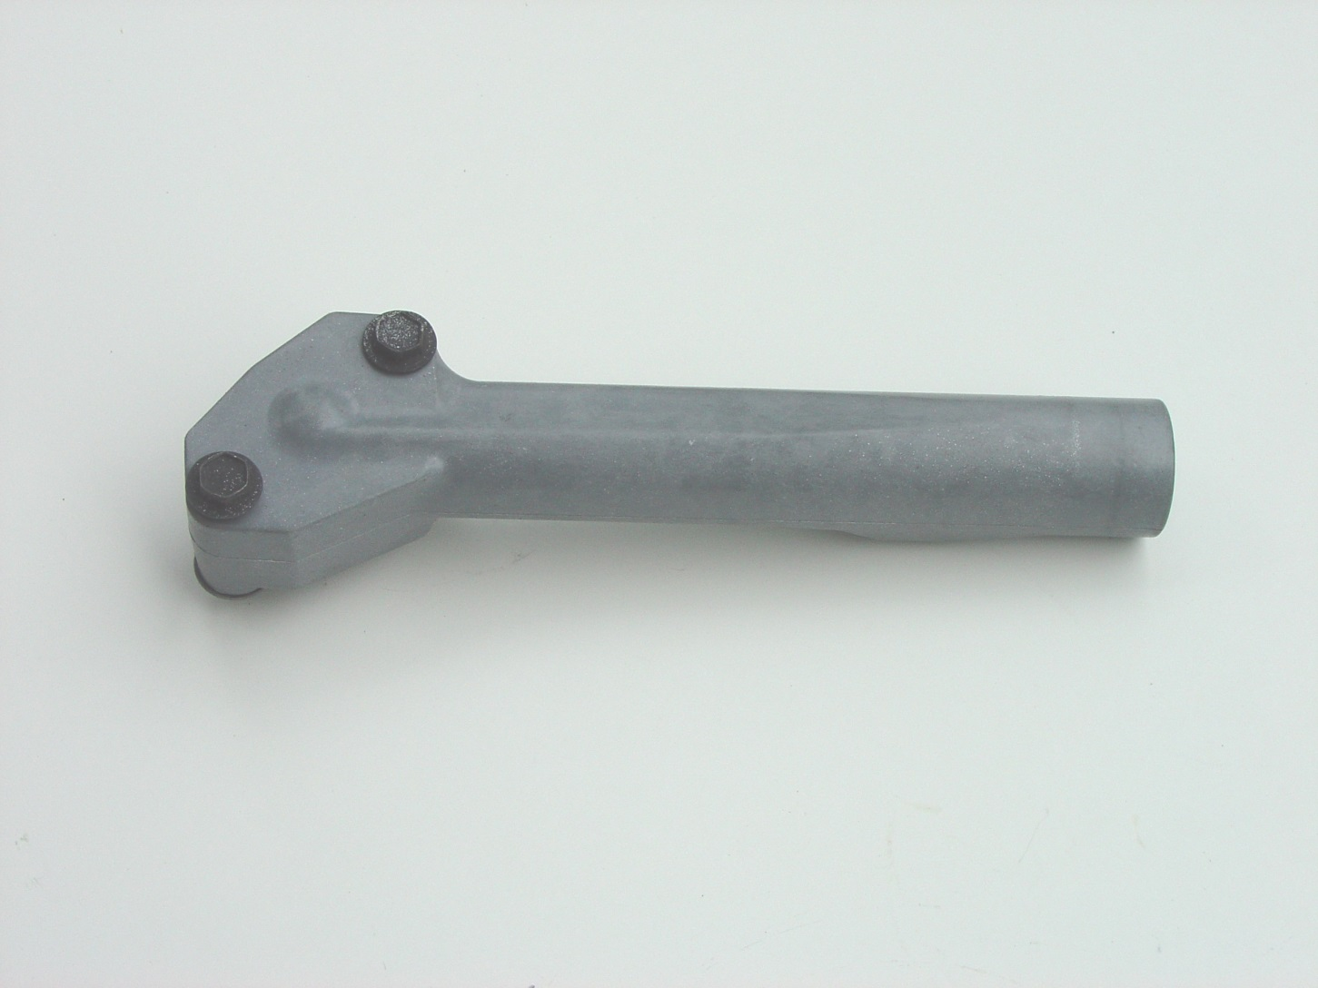

Slide 67
Intake Manifold

Slide 68
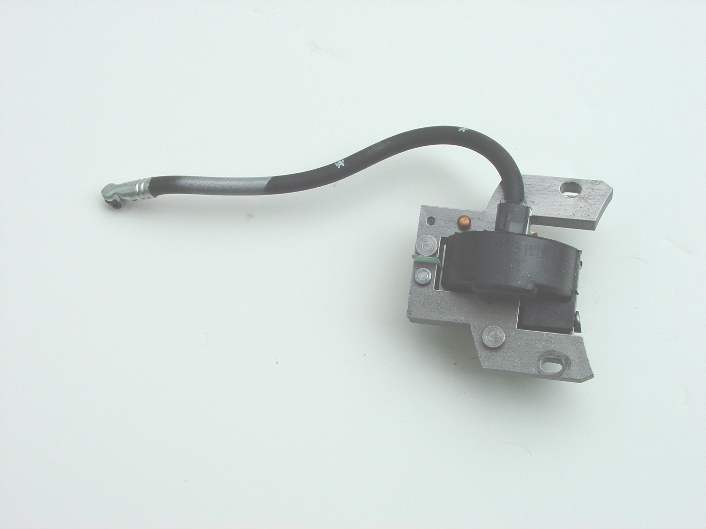

Slide 69
Magneto Armature

Slide 70
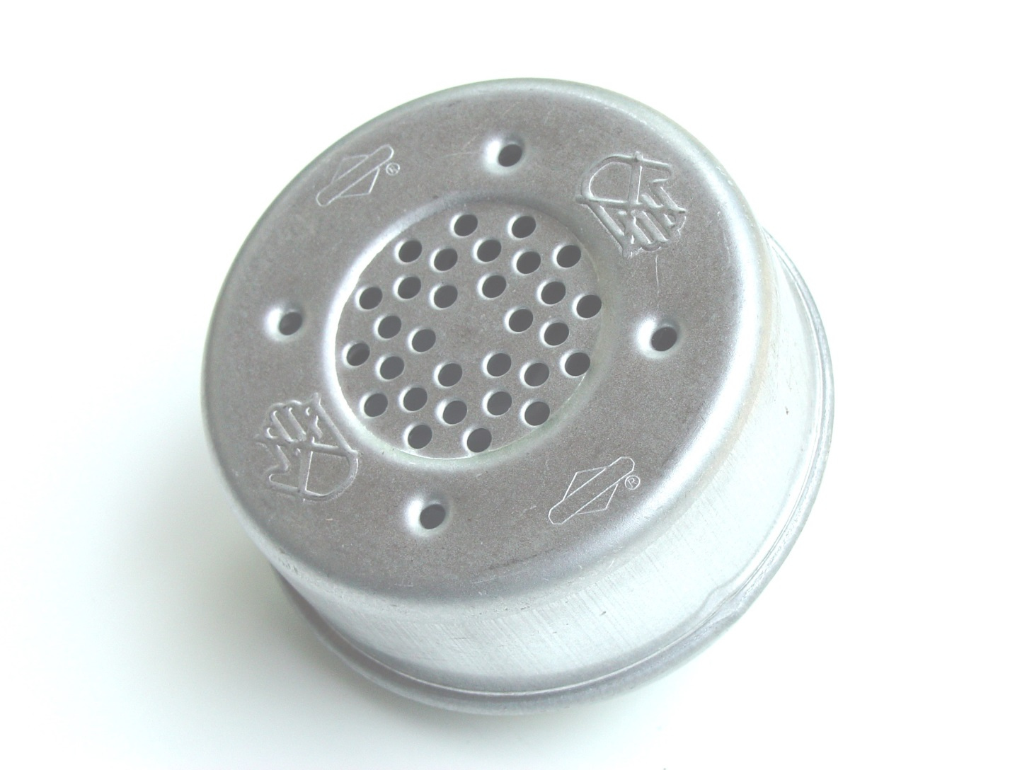

Slide 71
Muffler

Slide 72
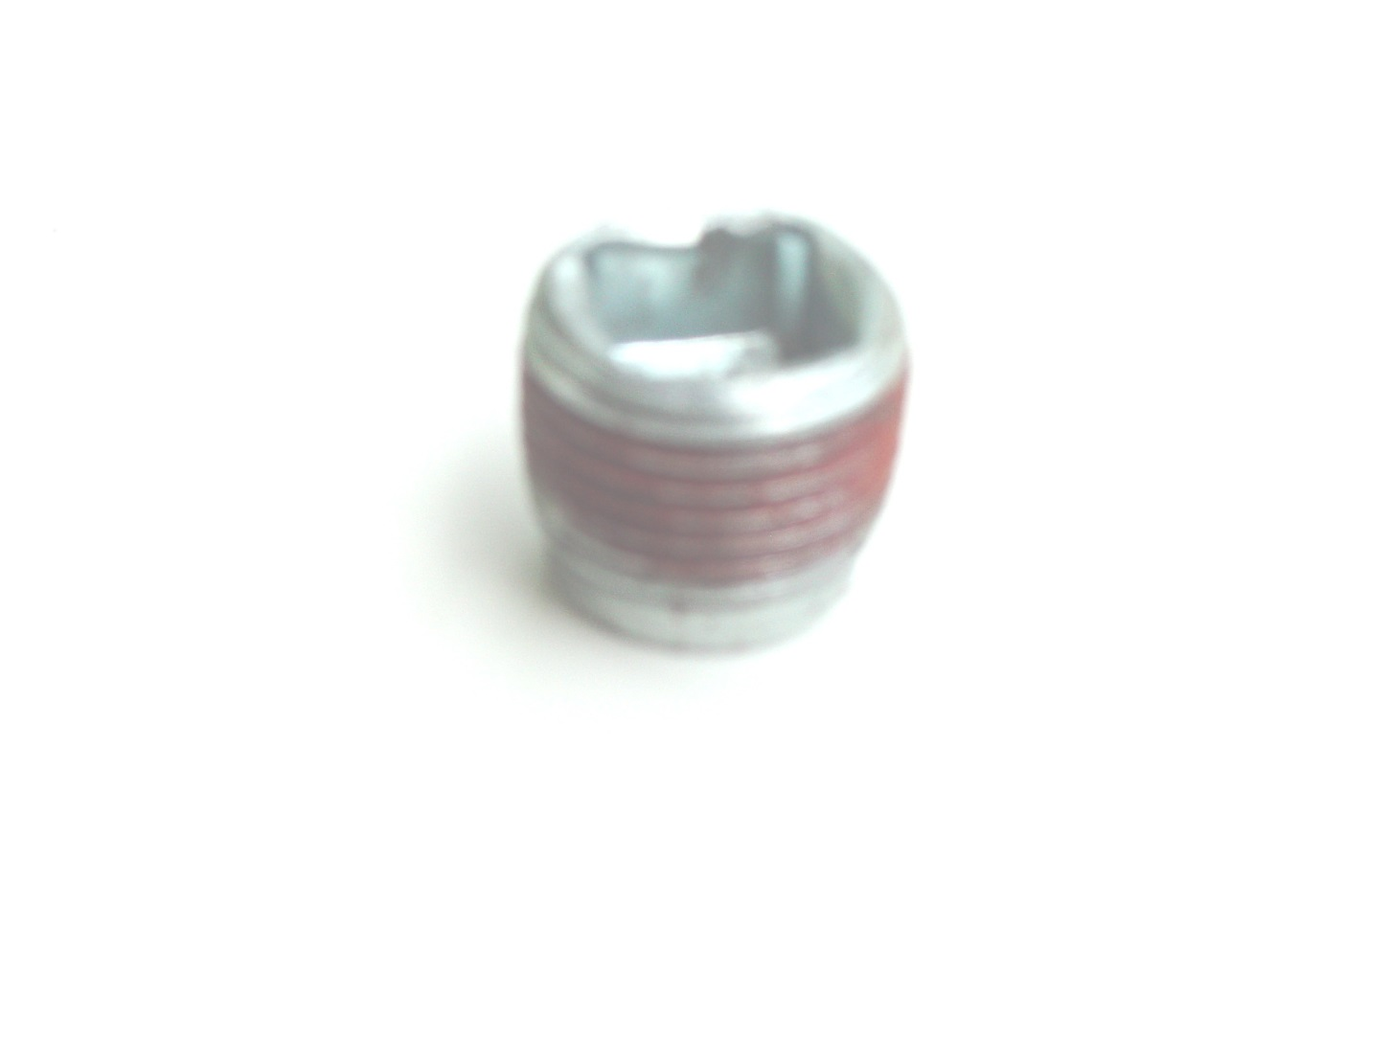

Slide 73
Oil Drain Plug

Slide 74
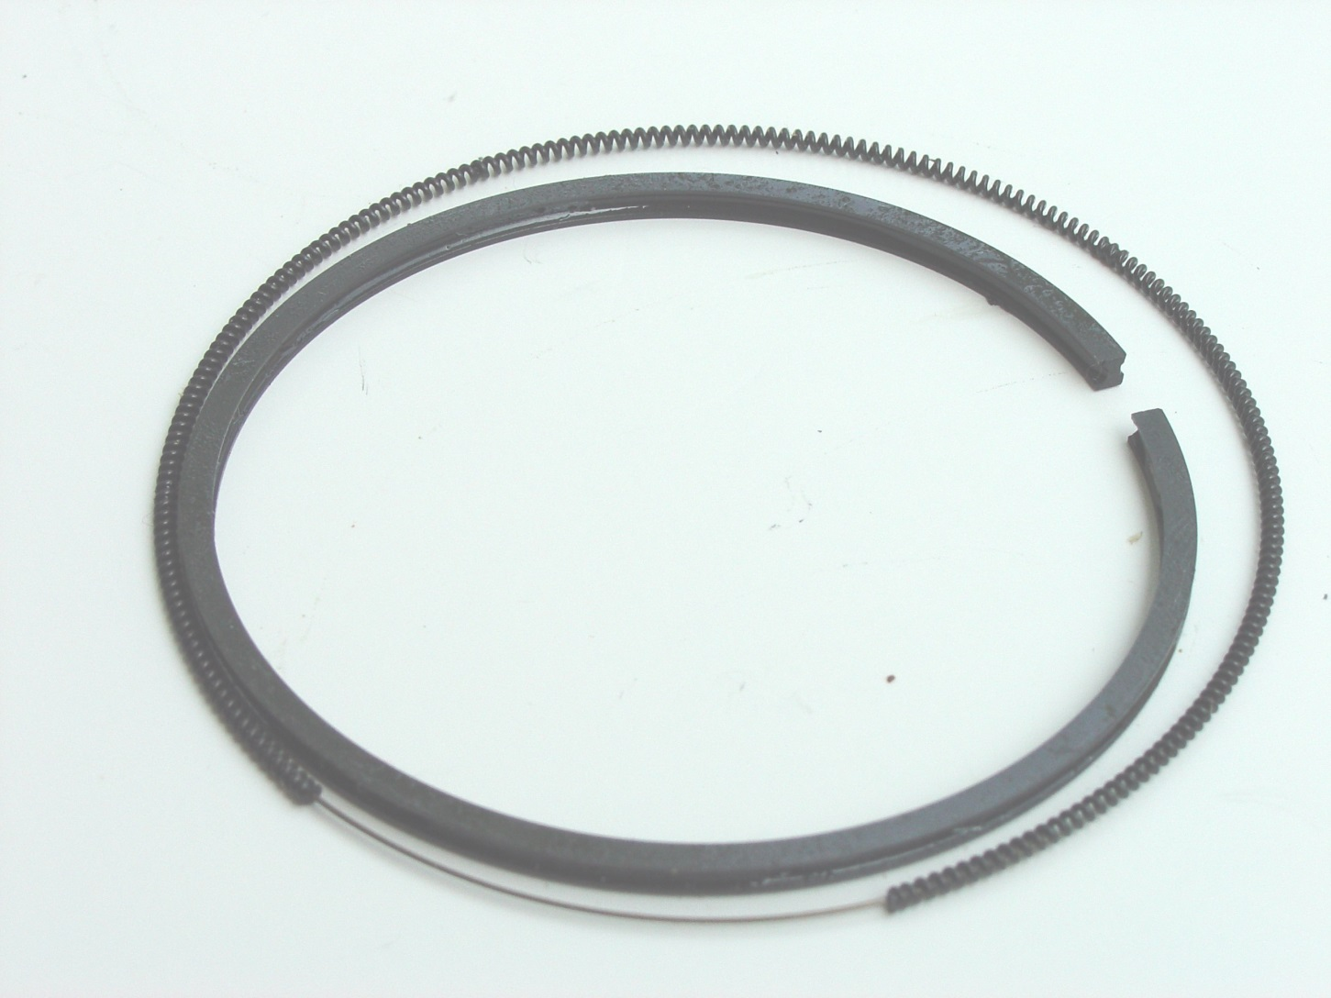

Slide 75
Oil Ring

Slide 76
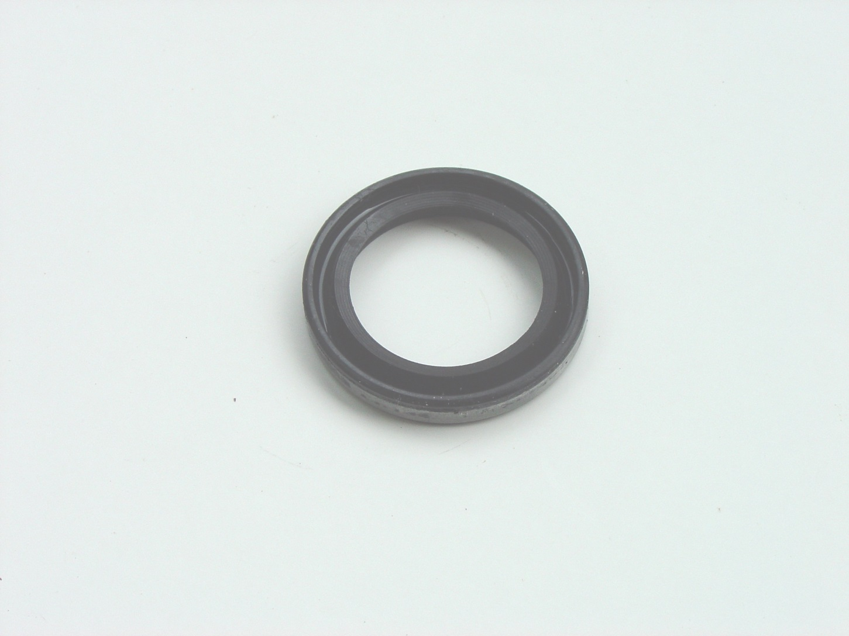

Slide 77
Oil Seal

Slide 78
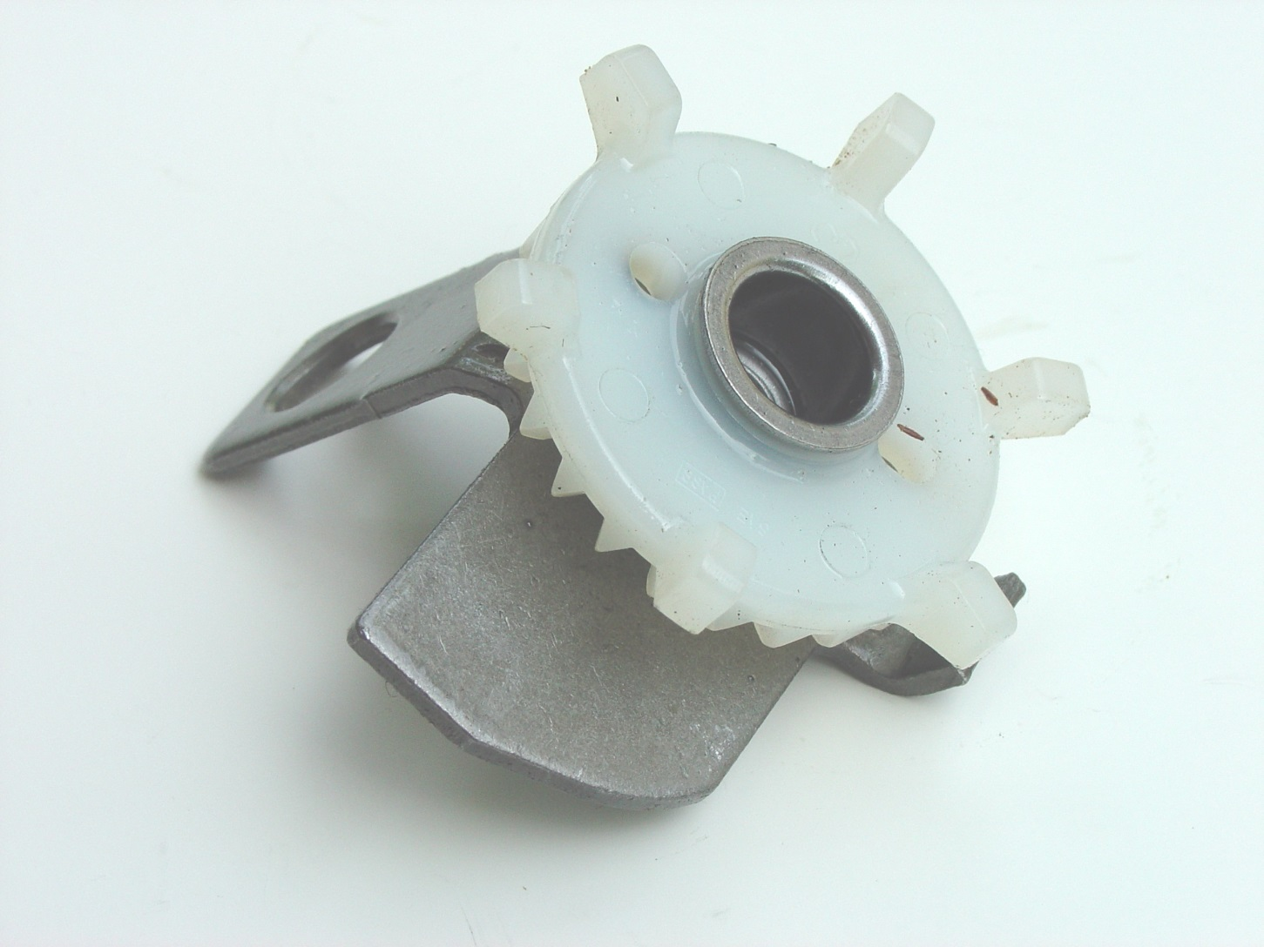

Slide 79
Oil Slinger

Slide 80
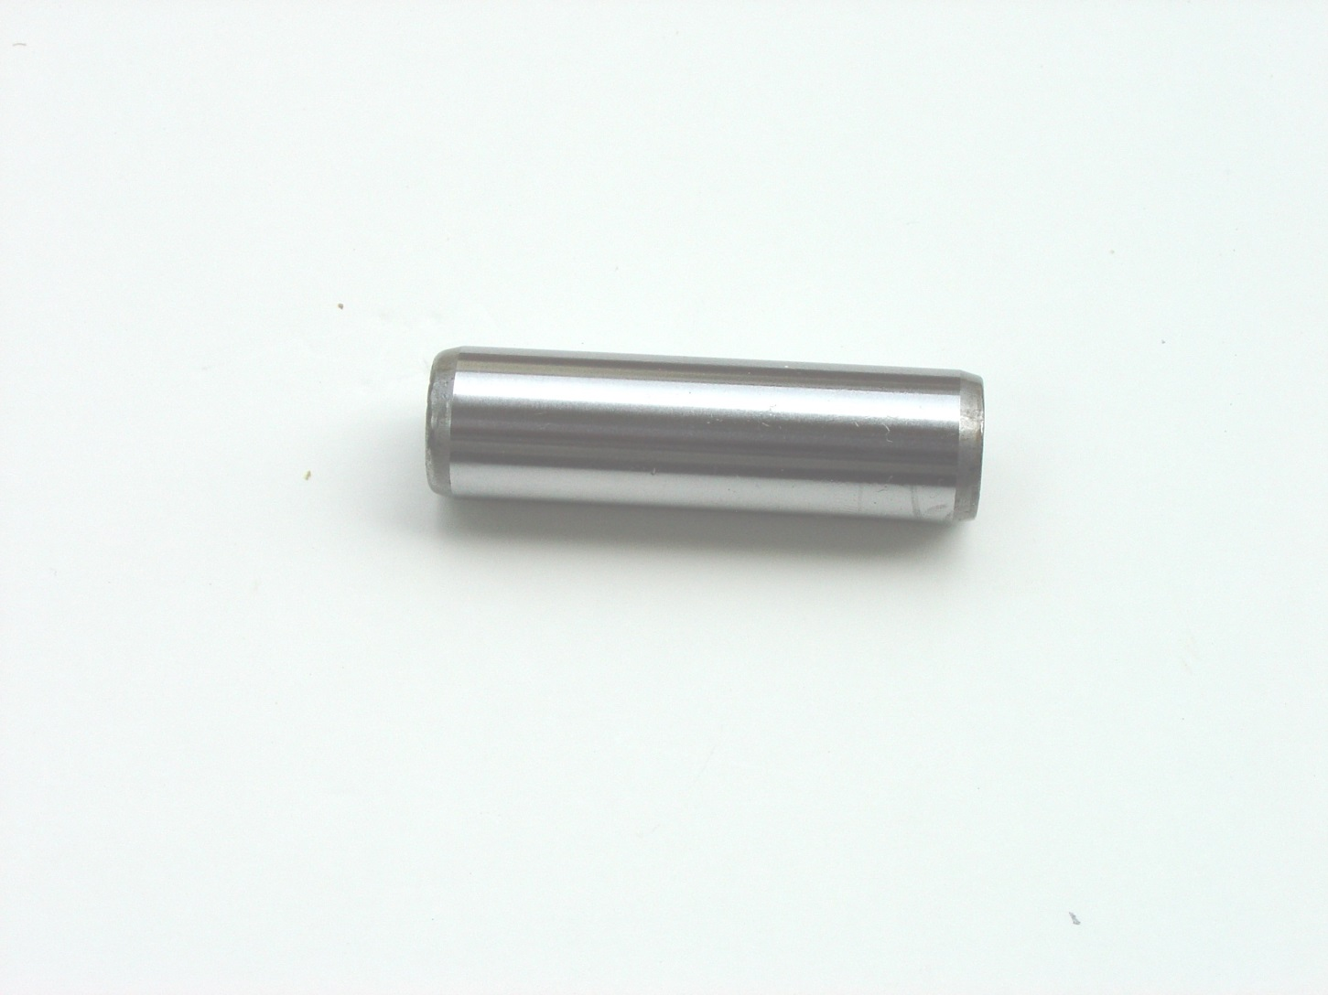

Slide 81
Piston Ring

Slide 82
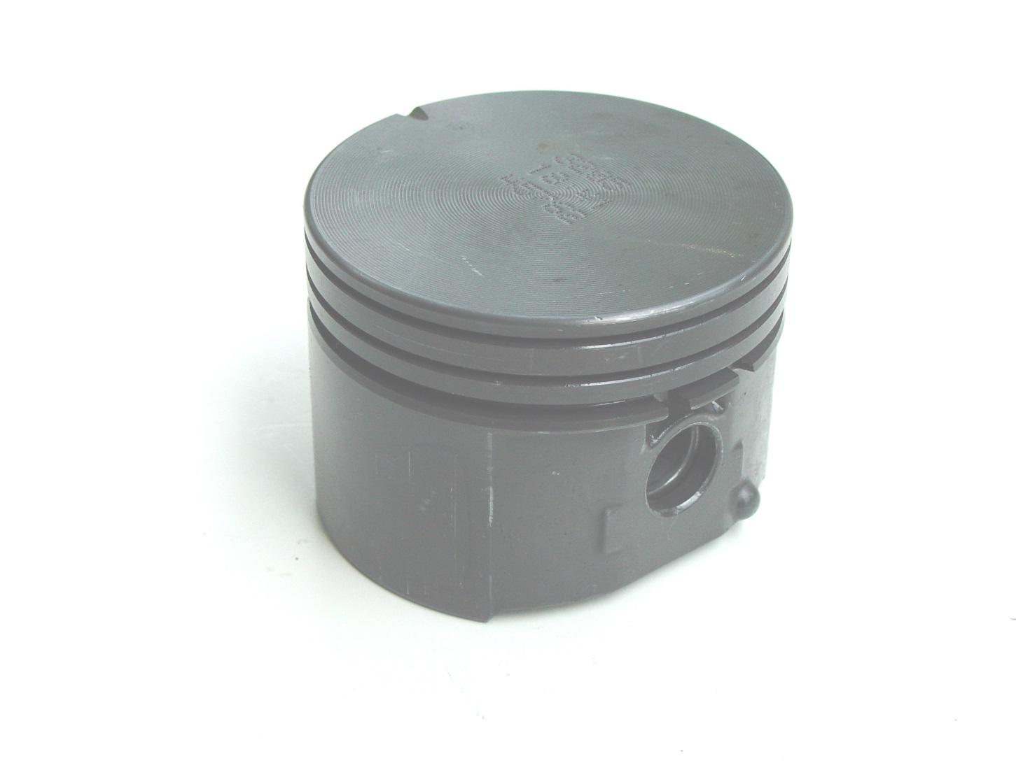

Slide 83
Piston

Slide 84
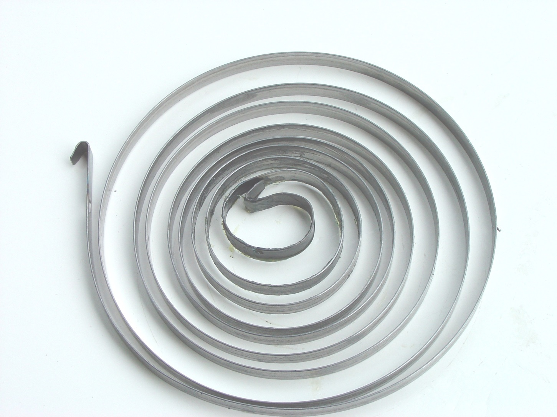

Slide 85
Pulley spring assembly spring

Slide 86
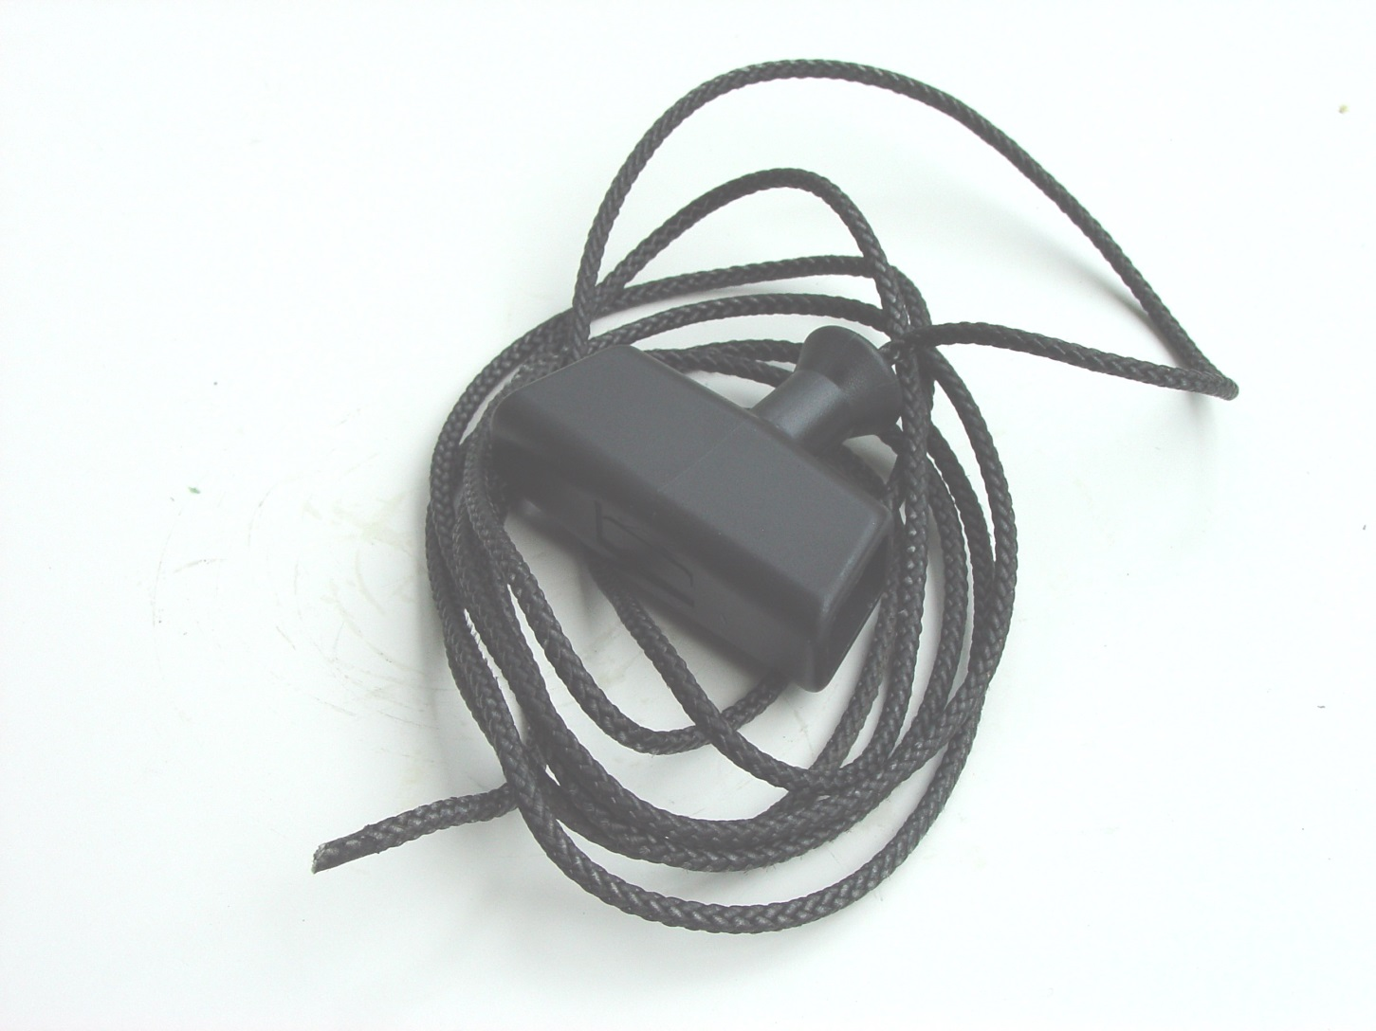

Slide 87
Rope Starter and Grip

Slide 88
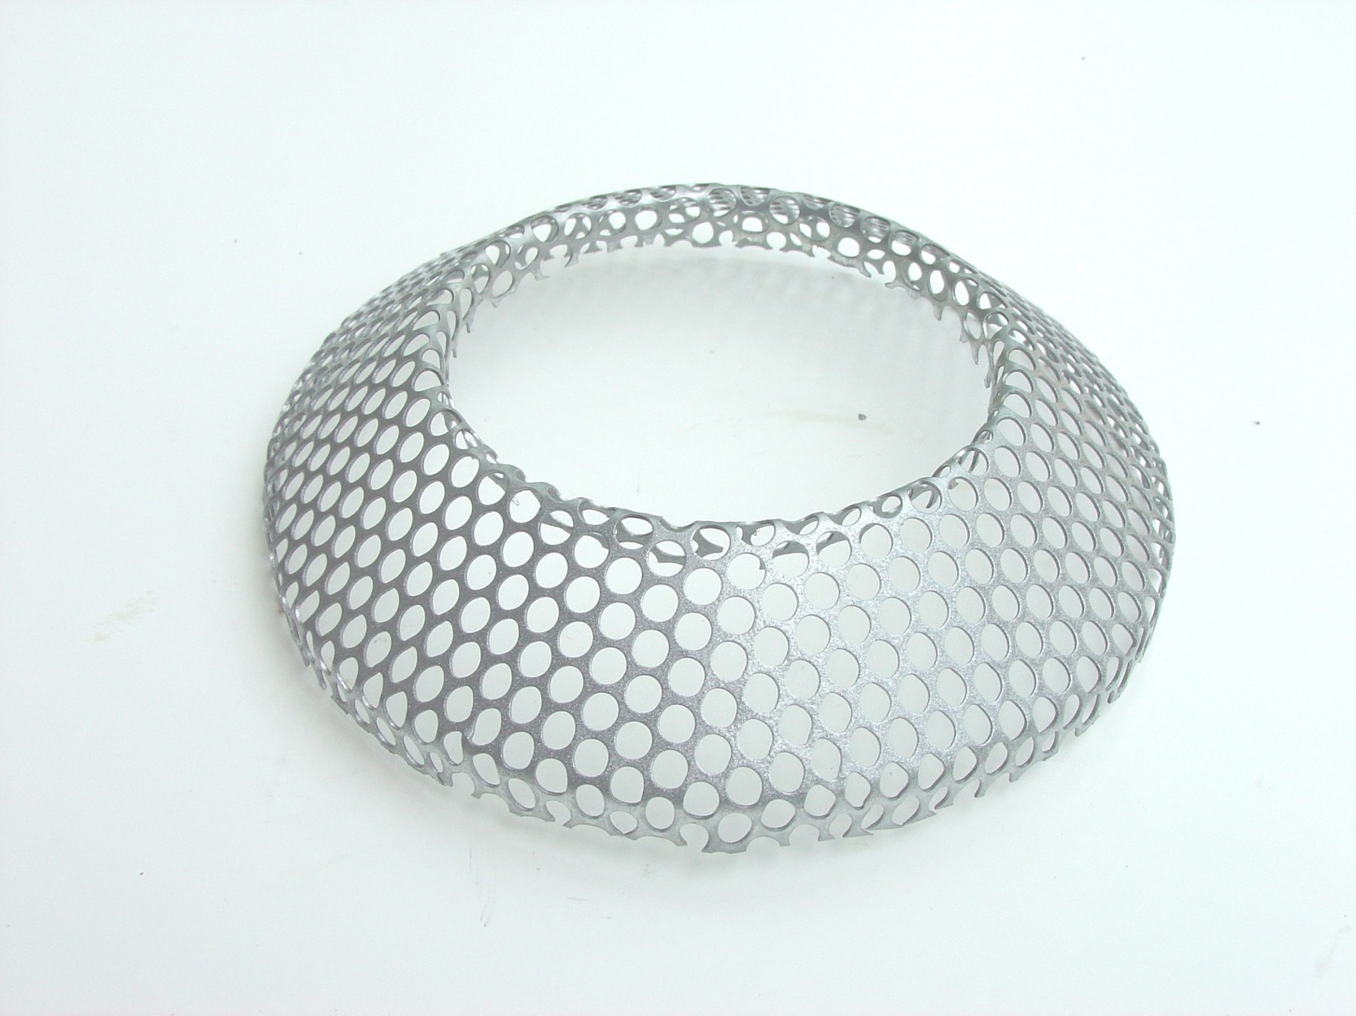

Slide 89
Rotating Screen

Slide 90
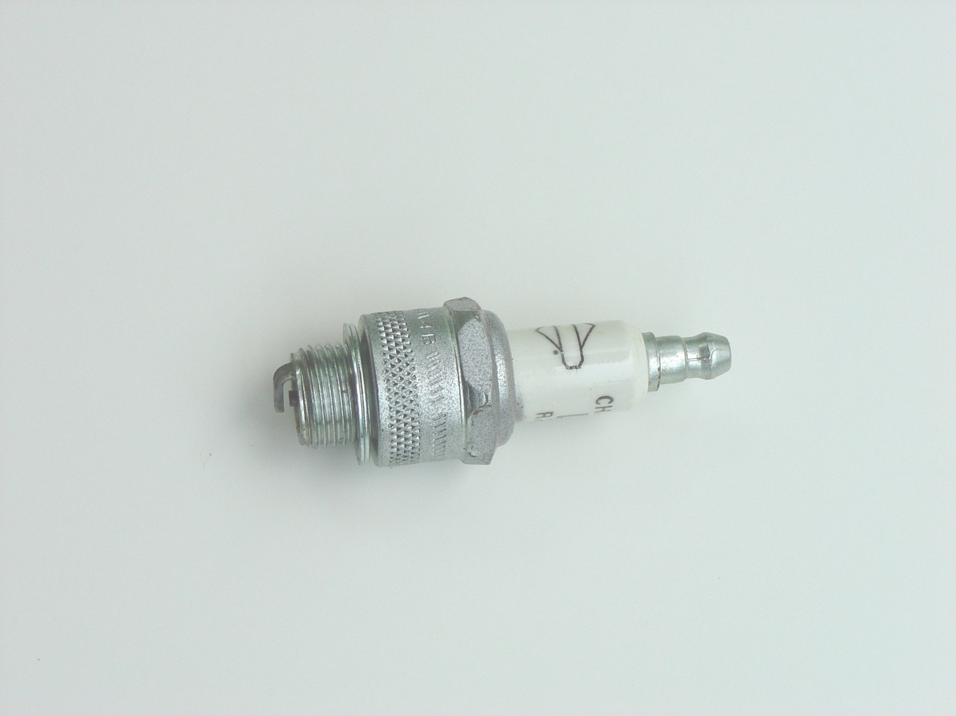

Slide 91
Spark Plug

Slide 92
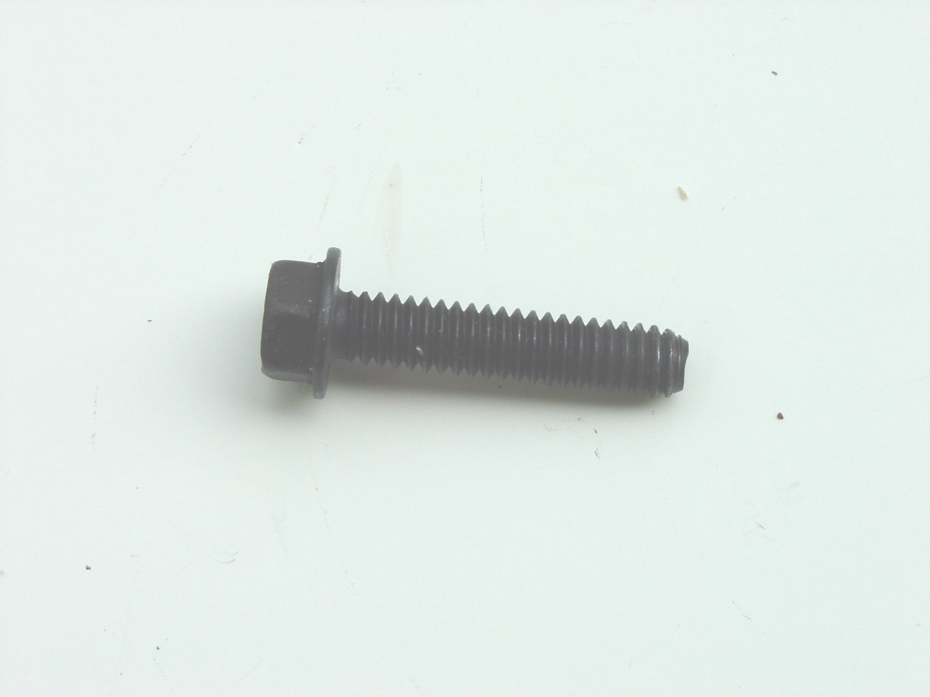

Slide 93
Sump Screw

Slide 94
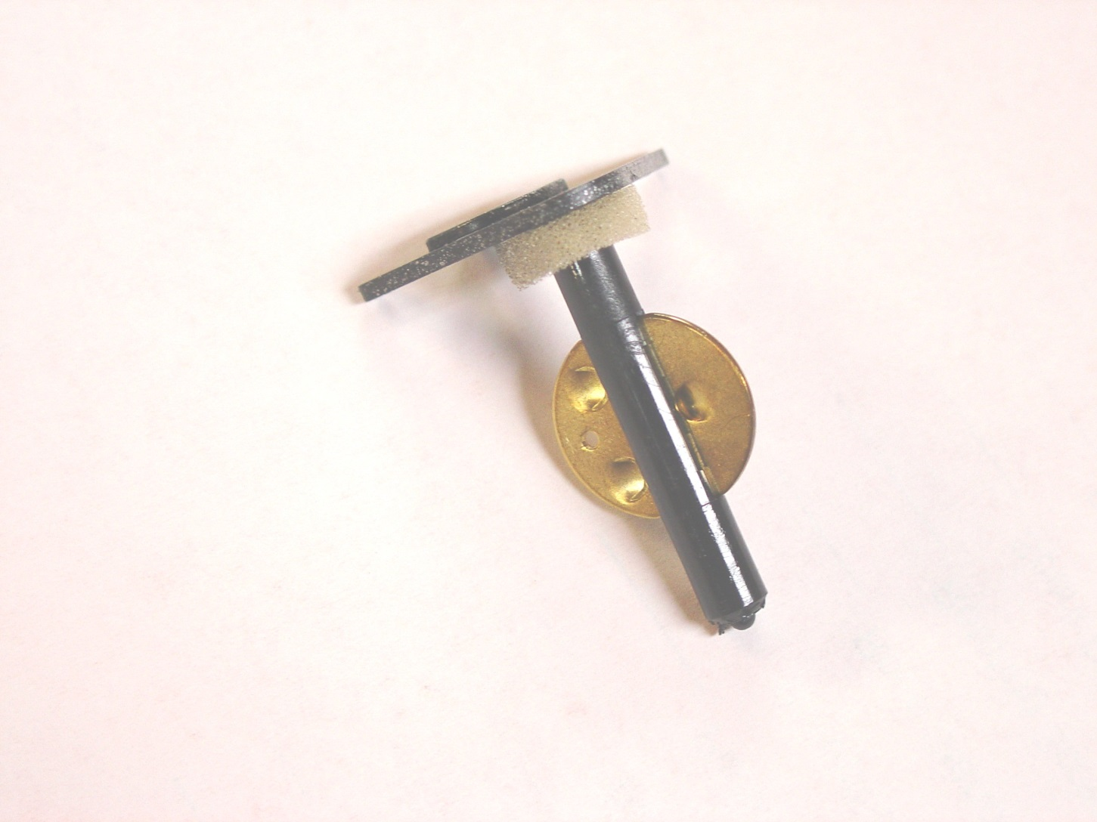

Slide 95
Throttle Shaft and Valve

Slide 96
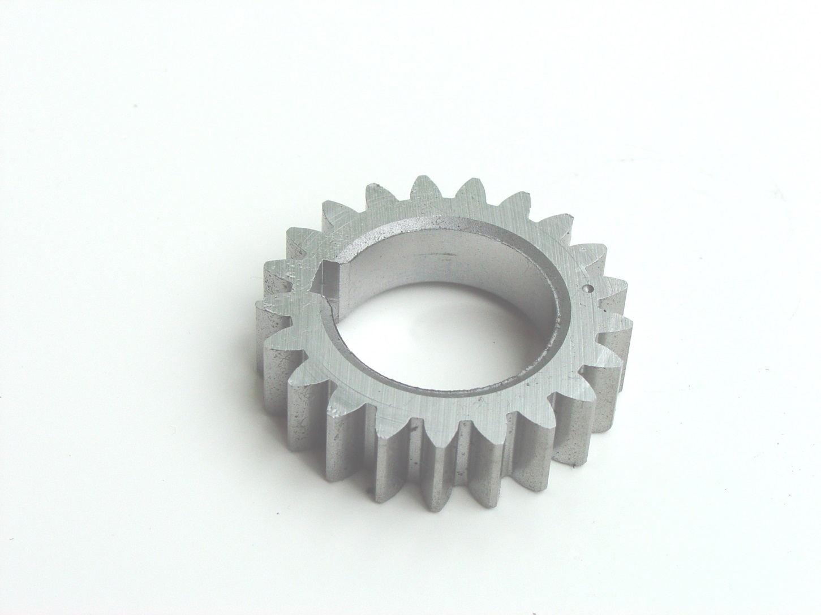

Slide 97
Timing Gear

Slide 98
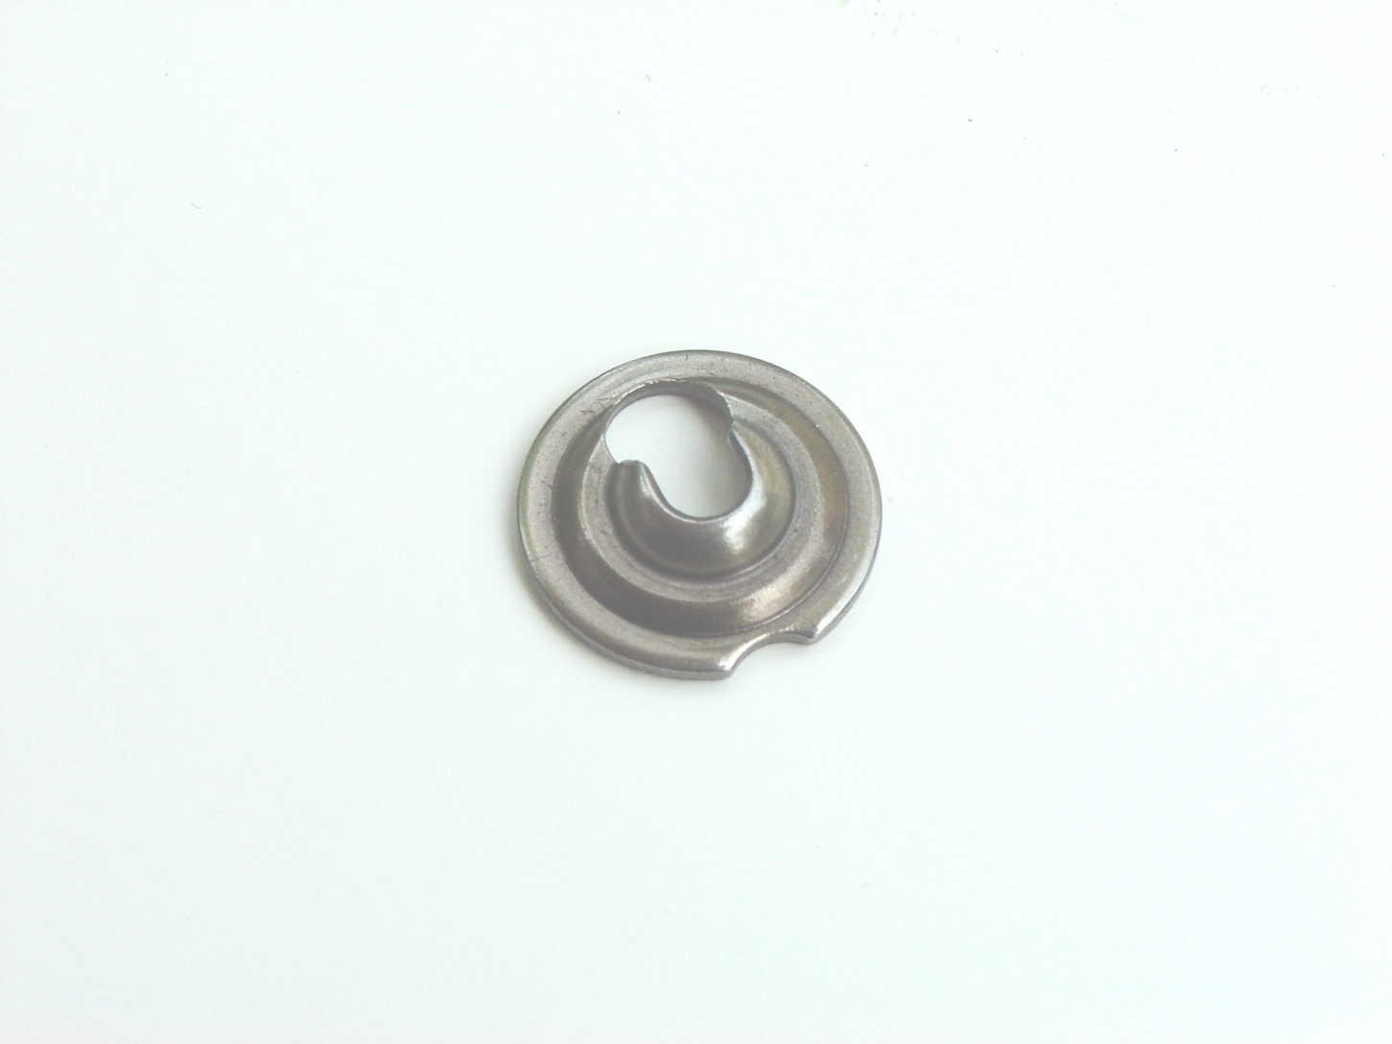

Slide 99
Valve Retainer

Slide 100
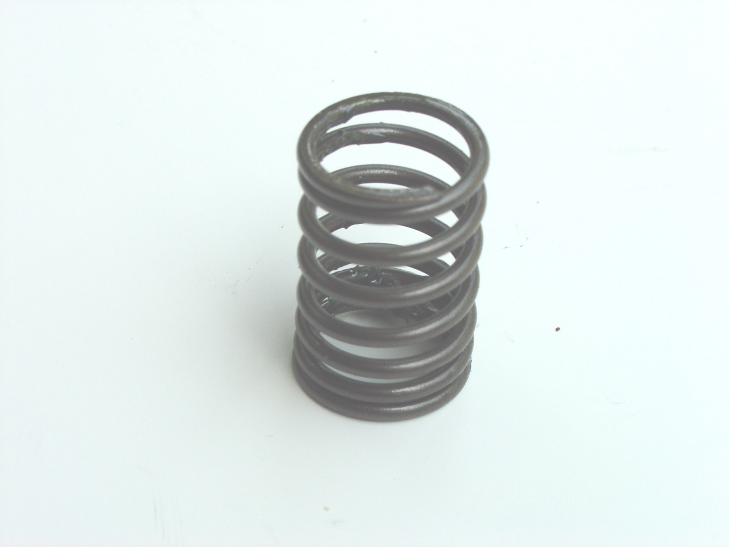

Slide 101
Valve Spring

Slide 102
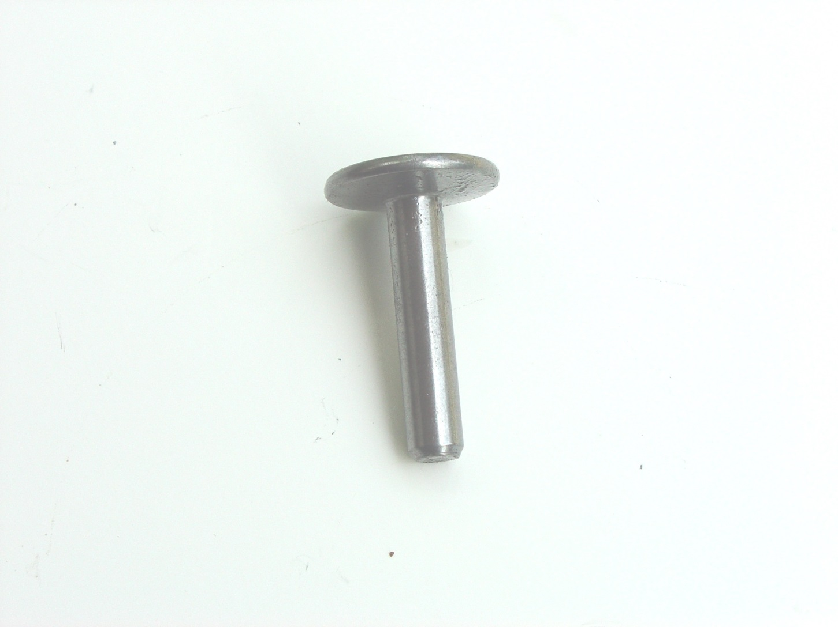

Slide 103
Valve Tappet

Slide 104


Slide 105
Valve

